Slide 1
Data Analyst Portfolio
BY: MUSKAN BANSAL
DATA ANALYST

Slide 2
Professional Background:
I am a Computer Science Engineer from Maharshi Dayanand University. I recently completed my BTech in 2023 with 9 CGPA. I have several skills including problem solving aptitude, understanding level of Reasoning, Decision making, good communication skills.
I have done multiple projects from age & gender detection using regression and classification model to making a small Arduino car that detects the smoke nearby using sensors and sprays water when the temperature exceeds the limit.
I have done multiple internships and volunteer work like, I was Machine Learning Intern at Grroom, Data Science Intern at LetsgrowMore, IT Intern at Infokart Pvt. Ltd., Data Scientist and Business Analyst at The Sparks, as for the volunteer work, I worked at Suvidha Foundation and Aashman Foundation where I wrote multiple articles to spread the awareness of education for the financially underprivileged children and women, not only this I also I also raised funds for the cause.
I have keen interest in AI, ML and Data Analysis and though I am a fresher, I can work on wide variety of technologies.

Slide 3
Table of Contents:
Professional Backgrounds ------------------------------------------------------2
Table of Contents ------------------------------------------------------------------3
Project 1 – Data Analytics Process --------------------------------------------4
Project 2 – Instagram User Analytics ----------------------------------------10
Project 3 – Operation Analytics and Investigating Metric Spike -------22
Project 4 – Hiring Process Analytics ------------------------------------------34
Project 5 – IMDB movie Analysis ----------------------------------------------44
Project 6 – Bank Loan Case Study --------------------------------------------63
Project 7 – Impact of Car features ---------------------------------------------79
Project 8 – ABC Call Volume Trend Analysis --------------------------------94
Appendix ------------------------------------------------------------------------------99

Slide 4
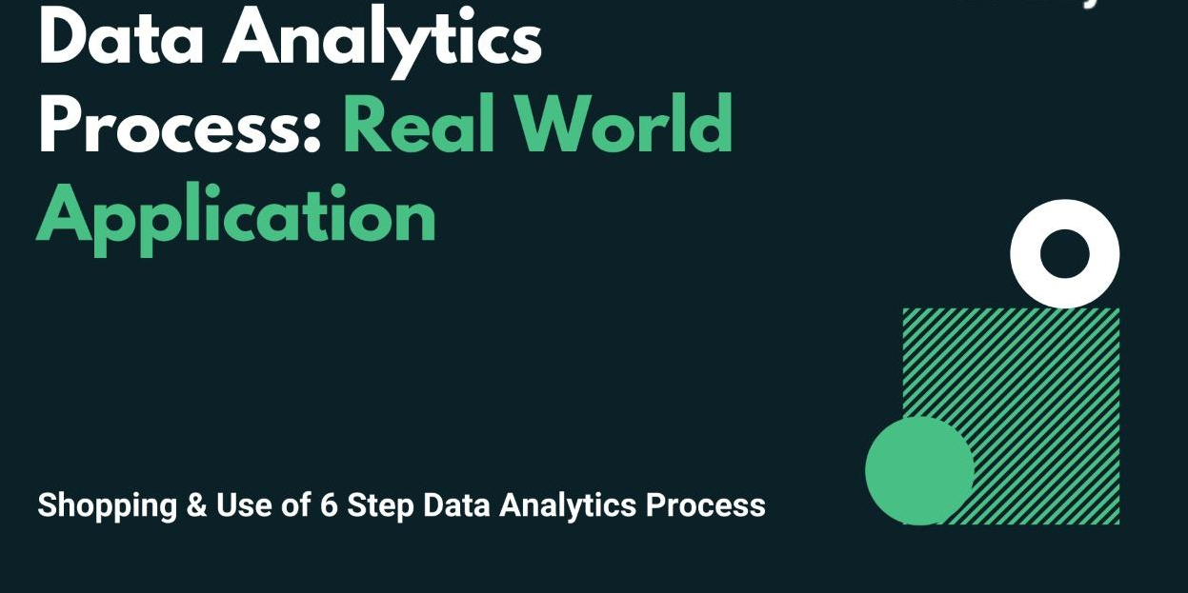
Project 1-

Slide 5
Description:
We use Data Analytics in everyday life without even knowing it. For eg : Going to a market to buy something .
Task:
Your task is to give the example(s) of such a real-life situation where we use Data Analytics and link it with the data analytics process. You can prepare a PPT/PDF on a real-life scenario explaining it with the above process (Plan, Prepare, Process, Analyse, Share, Act) and submit it as part of this task.
Plan
I will first decide what are all my priorities and what all things I need to accomplish in the longer run. As well as what I need to do for my short term goals.
For example, currently my focus in on my mental and emotional health. My studies and getting a decent job for which I also need to learn the relevant skills. I also need to study for the final semester exams and work on my final year project. Apart from that I also need to focus on my physical health and eating habits else I get sick easily.

Slide 6
Prepare
Now, that I know all my priorities for now, I need to understand how much time I am left with before my exams start, how much time I am left with to submit my final year project, how much time I have before the placement drive begins. I also need to manage my menstruation cycle as sometimes it can be a hinderance. So organising my desk, selecting all the courses and study material. Going through my syllabus for the exam and talking to my professors about my final year project to understand it better. I will also talk to my parents so that I can make sure I eat at least one fruit a day and stop munching on junk. I will make sure my study table is clean and no hinderance from any other activity. Deleting social media applications that distract me and talking to people who help in my growth. Setting an alarm clock so that I wake up early and do yoga, writing journal before sleeping to keep track of all my daily activities.
Process
Now, that I have planned my priorities and have some understanding, I can discipline myself and set a better routine so that I achieve my goals.
6:00 AM : I get up, wash my face and go for a run. This helps me stay fit and helps me mentally and emotionally.
8:00AM : I do 10 minutes of meditation and breathing exercises which is good for my eyesight and focus. I then do 30 minutes of yoga as it will relax my body after coming from a run and helps my muscle to regulate well.
9:00 AM : I now sit, by this time I aim that I have had at least 2 glasses of water as I get sick and my family doctor always advice me to drink more water. I read my to do list and start studying.
12:00 PM : I shower and take a break to eat. At this time mostly I watch something on netflix or prime or I read as I love reading.
1:00 PM : I again go back to study. I take breaks.

Slide 7
6:00 PM : By this time, my mind is fried and exhausted so I sit and do nothing, sometimes I make myself sandwich and check my notifications or play sudoku.
7:00 PM : Since I love to go gym, but lately I have been lazy. I go to gym when I am not lazy and there I do as I am told by my trainer or sir there, my favourite is legs and dead-lifts.
8:30 PM : By this time, I finish all my exercises and come back home. I rest and chug 2 glasses of water. My aim is to at least have 8 glasses of water by the end of day and by 9PM I am already down to 6 glasses of most days. After resting for about 15-20 minutes I go and shower.
9:30 PM : I now have dinner with my family and spend time with my parents, my brother lives in US and my parents miss him a lot so I make sure to spend some time with them at least.
10:30 PM : On good days I again sit and study, however mostly I watch prime or read and if not that I write, I love writing. I also started a blog recently and I try to stay active with my writing and if I don’t have any idea rolling in my head I talk to my friends.
Before sleeping : I try to sleep early so that I can get up at 6 in the morning, before going to bed I write my study plan and what all topics I should be covering according to my priorities, I brush. Sometimes mousturies since I got dry hands, chug another glass of water and sleep.

Slide 8
Analyse
The above process is ideal, however on most days I slip but I keep trying, when I skip a topic that I should have studied, I keep that one for weekends if I don’t have plans with my family or friends. When I am on my periods, I skip waking up early and going for a run, I also make sure to eat more during my menstruation. I need to keep check on my protein intake and water intake well to function well overall. As when I eat and drink well, and when I sleep well, I exercise well which regulates blood flow and helps me focus on my studies so I study and learn well too. I understand, I am not perfect and a lot of times I slip as I make this routine a bit challenging for myself however my goal is to optimise my day in a way to gain maximum outputs, I take rest when my body or mind asks me to. Understanding and listening to ones body is necessary.

Slide 9
Share
I also communicate my plan with my parents, trainer/sir and close friends so that when I slip or feel bad, they are there to motivate and help me through. My mom makes sure I eat fruits and have enough protein in my diet, a lot of times I educate her about the nutrients as well. My dad makes sure I am well and always asks me about my day after coming from work and help me guide when needed, My trainer make sure I am physically well and he helps me maximise my muscle gain however I consider myself weak and I get sick pretty easily. My close friends help me stay focus and I do same for them.
Act
Now, that I have done all the steps, the only thing is to act upon it as planning without execution is of no use.
Final Thoughts: This assignment was not just an assignment for me. I wrote genuinely as this is what I mostly do. The assignment however did help me analyse my routine better to maximise my day.

Slide 10
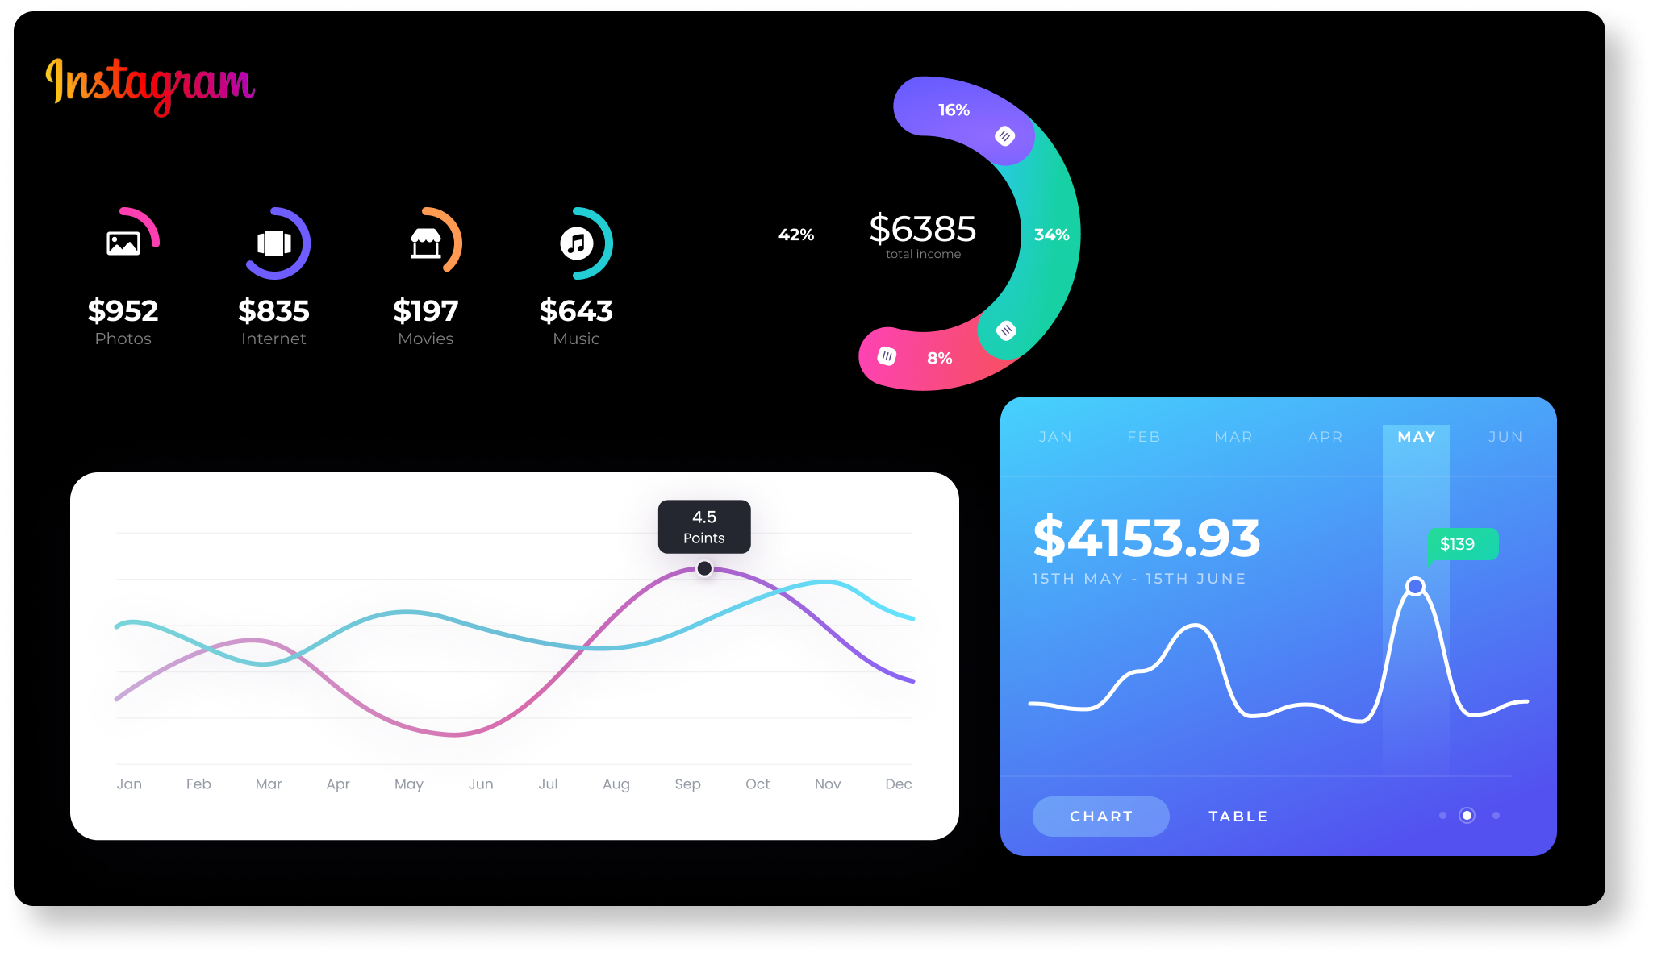
Instagram User Analytics:

Slide 11
Description:
When I first read the questions, I was quiet scared to even try but as I gave second and third read, it got simpler. When I finally imported all the data set into my SQL Workbench and ran the first question query that was asked according to my understanding and I got the right output, it gave me confidence. This project helped me build confidence and helped me understand what types of queries a data analyst is required to solve on a daily basis. This project is about basic understanding of how data analysis is done on a basic level.
The project was divided into two parts:
1. Marketing
2. Investor Metrics
In the marketing part, I learned different ways a company deals with their services or products to increase the profit while keeping the losses to minumum. Main aim being to optimise the resources they have well enough to get the highest ROI. Rewarding the loyal customers so they stay connected to launching AD Campaigns. Starting new contests to increase the user engagement. However, in the Metrics part, I learned how imporant it is for a company to know it’s users well, to have the knowledge of the user engagement and also to know about the ill practices if a user is following. Aim is to keep it real and as authentic as possible.

Slide 12
APPROACH AND TECH-STACK Used:
My approach was pretty simple, I went through the provided datasets and the guven installation resources, the video on basic SQL Workbench helped me a lot and that’s how I learned to import the dataset. Even though there was some connecting issue with my SQL port because of which I spent an entire day first figuring out how to resolve that. I was unable to import data or even launch a new one due to porting issue. After troubleshooting, I finally imported the data and was ready to solve the queries.
I read the question twice and the began writing queries. There were times when I could think of the approach but didn’t really know how to execute them to I also went to SQL Documentation.
Question 1, 2 and 4 were easy however I took some time to solve question 3. I learned about the “dayname” function here for which I googled. The last two questions were just as easy.
I have explained below each answer how I have come to that solution and understanding.
TECH-STACK Used: I used MySQL Workbench 8.0 CE to run all the queries.

Slide 13
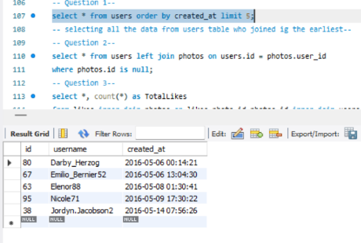
A) Marketing: The marketing team wants to launch some campaigns, and they need your help with the following
Rewarding Most Loyal Users: People who have been using the platform for the longest time. Your Task: Find the 5 oldest users of the Instagram from the database provided

Slide 14
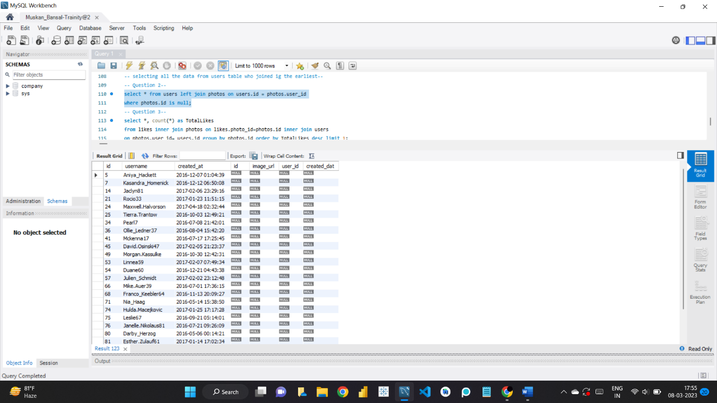
Remind Inactive Users to Start Posting: By sending them promotional emails to post their 1st photo. Your Task: Find the users who have never posted a single photo on Instagram

Slide 15
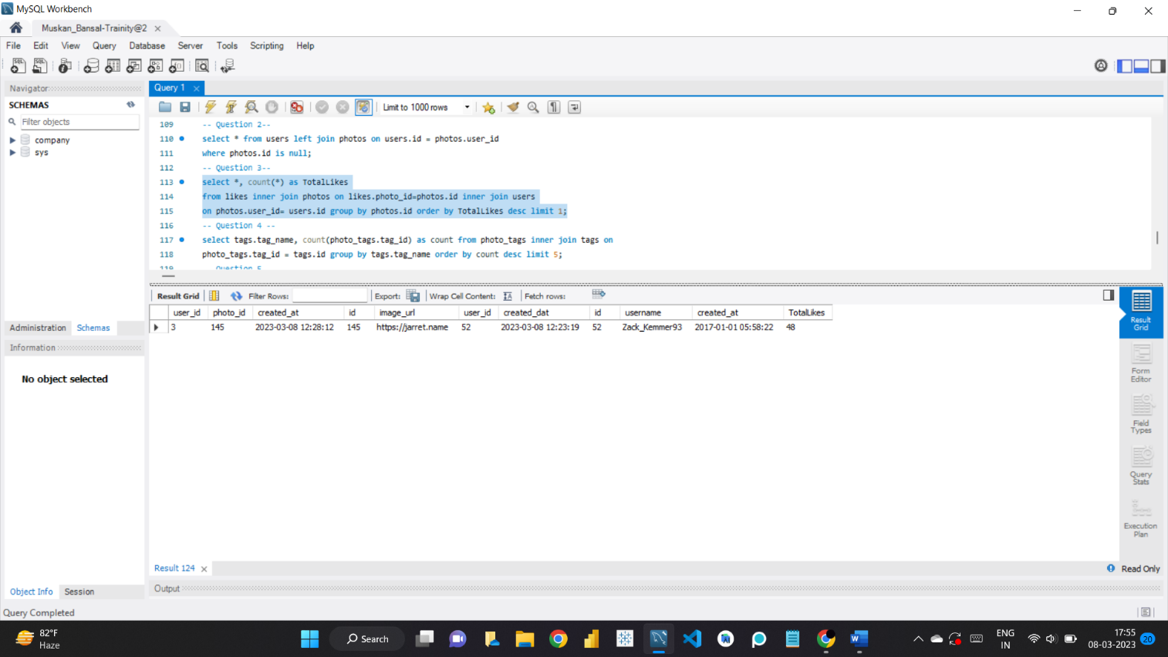
Declaring Contest Winner: The team started a contest and the user who gets the most likes on a single photo will win the contest now they wish to declare the winner. Your Task: Identify the winner of the contest and provide their details to the team

Slide 16
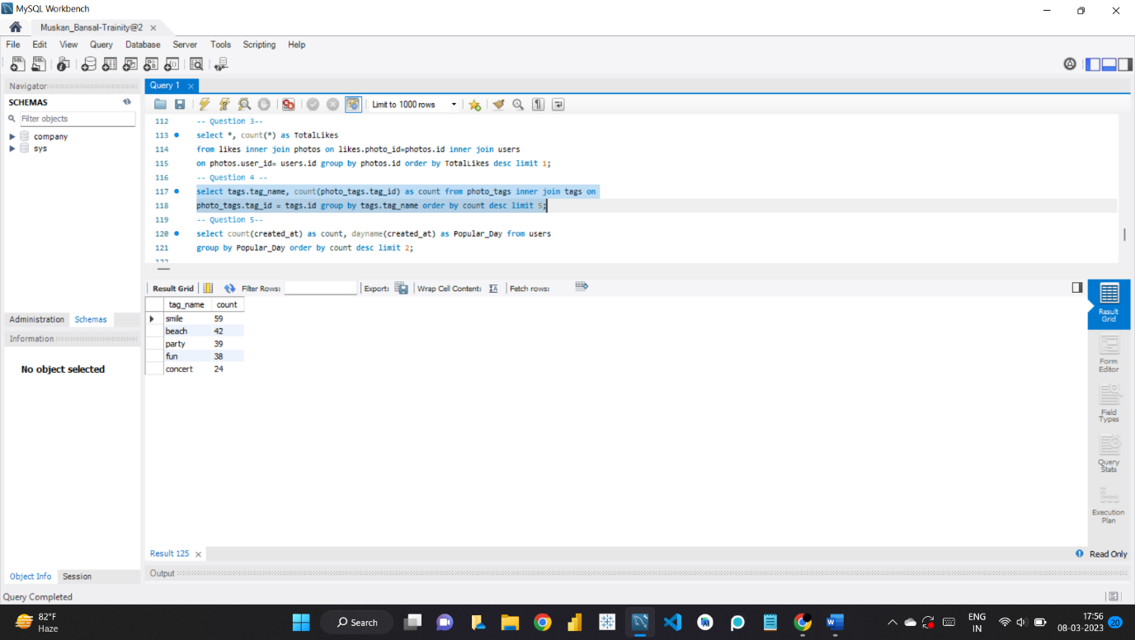
Hashtag Researching: A partner brand wants to know, which hashtags to use in the post to reach the most people on the platform. Your Task: Identify and suggest the top 5 most commonly used hashtags on the platform

Slide 17
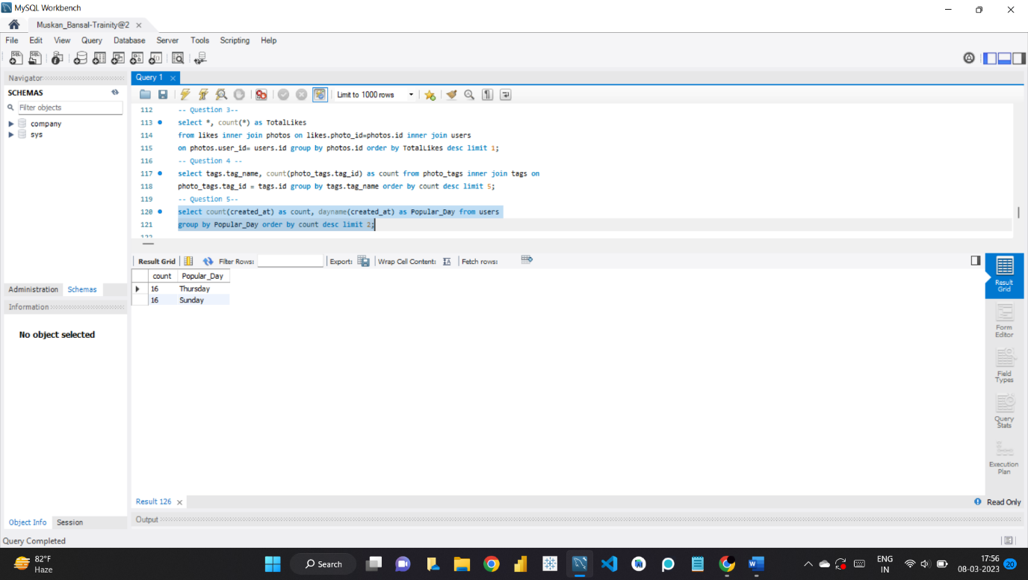
Launch AD Campaign: The team wants to know, which day would be the best day to launch ADs. Your Task: What day of the week do most users register on? Provide insights on when to schedule an ad campaign

Slide 18
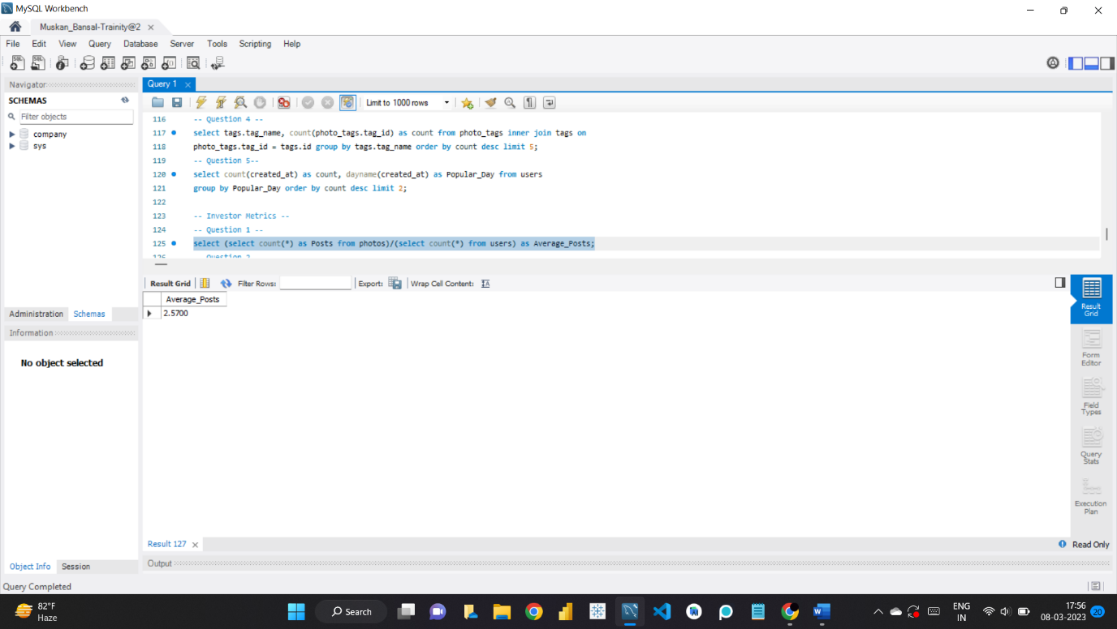
B) Investor Metrics: Our investors want to know if Instagram is performing well and is not becoming redundant like Facebook, they want to assess the app on the following grounds User Engagement: Are users still as active and post on Instagram or they are making fewer posts Your Task: Provide how many times does average user posts on Instagram. Also, provide the total number of photos on Instagram/total number of users

Slide 19
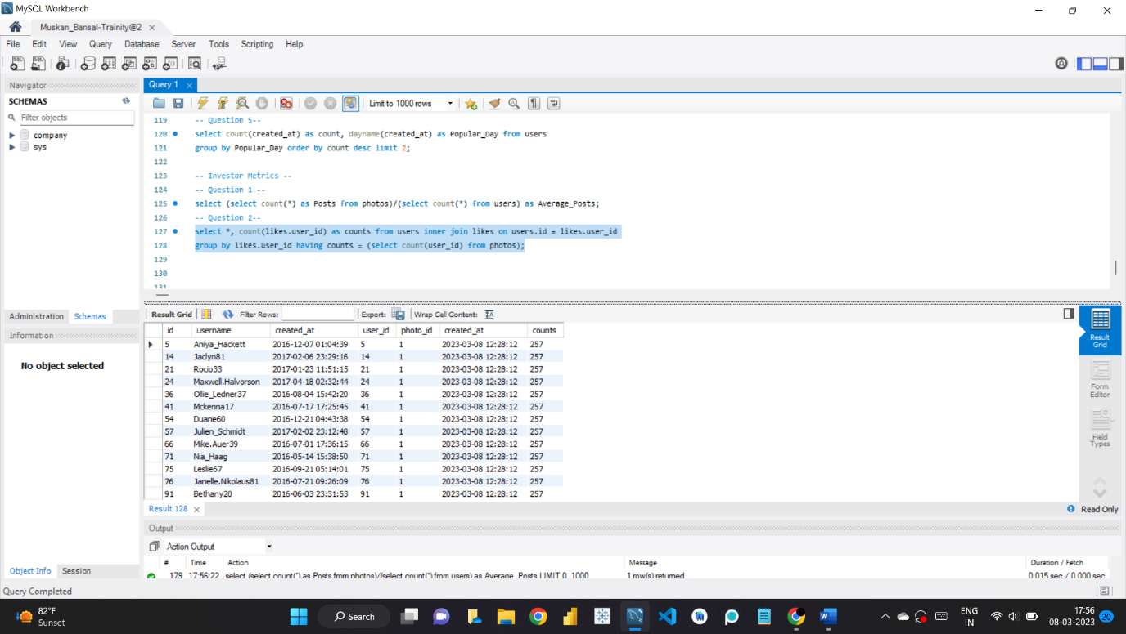
Bots & Fake Accounts: The investors want to know if the platform is crowded with fake and dummy accounts Your Task: Provide data on users (bots) who have liked every single photo on the site (since any normal user would not be able to do this).

Slide 20
INSIGHTS:
I learned about SQL Workbench.
I got to know about functions like ‘dayname’.
I understood how a company has to deal with multiple queries to optimise their profits the most.
I learned why Marketing is so important and not just fenced to spreading information about a certain product/services.
I understood why it is important to reward users and why a company sends mails to uses and how they get the information regarding who to send.
I learned how company decides when to launch an AS Campaign or why hashtags could be an important information.
I also learned, why user engagement is important and how company finds the data of users using certain queries, they can easily get the exact data they want from a large amount of data within seconds which is not possible humanly.

Slide 21
RESULT:
Solving queries and completing this project gave me confidence. I learned about new functions and how to troubleshoot if and when port is not connecting. I learned the basic of SQL Workbench that how it has 3 major components and why it is used in so many places, it has wide variety of functions, can easily import/export data and a lot more. The three major components being:
1. MySQL Connections
2. Models
3. Migration
I solved all the queries on my own with the amount of dataset given, which I know was not large however it was my first time working on even this small amount of data. I am ecstatic that I opted for this course and looking forward for the future projects.
If there is any mistake or update or suggestion, you can help me letting know for my future projects via mail: muskannbansall577@gmail.com

Slide 22
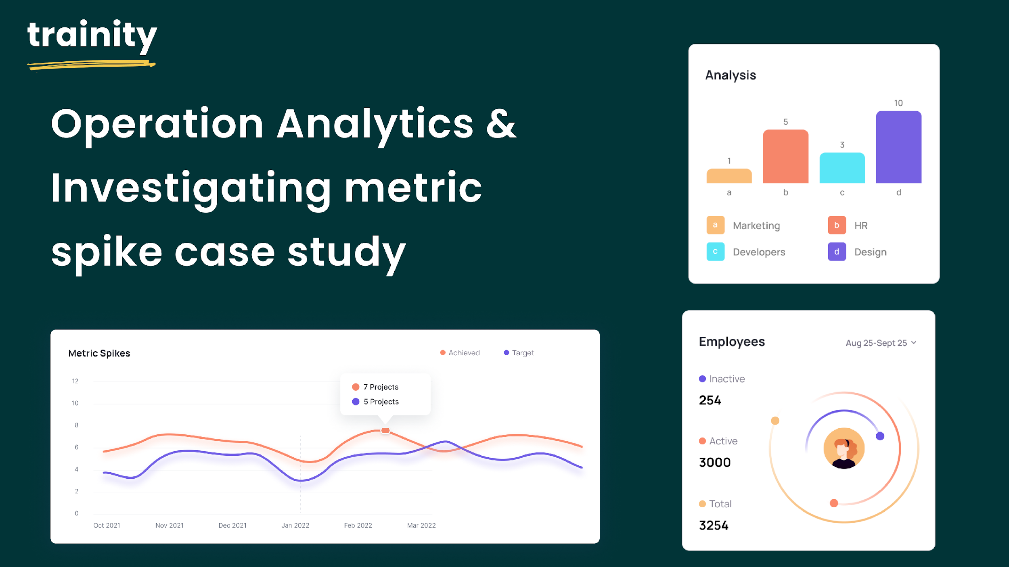
Operation Analytics and Investigating Metric Spike:

Slide 23
DESCRIPTION:
This project is about OPERATION ANALYTICS AND INVESTIGATING
METRIC SPIKES. The project is based on ADVANCED SQL concepts.
Operation Analytics is done for end to end operations of the company to
to find the areas for improvement. It predicts the overall growth or
decline of companies fortune. Investigating for metric spikes is a
crucial part to answer various questions on daily bases for
companies functions and growth.
As Lead Data Analyst, I was provided with different Data sets,
tables from which I was supposed to derive certain insights and answer
the questions asked by different teams.

Slide 24
CASE STUDY 1
Number of jobs reviewed: Amount of jobs reviewed over time. Your task: Calculate the number of jobs reviewed per hour per day for November 2020?
Throughput: It is the no. of events happening per second. Your task: Let’s say the above metric is called throughput. Calculate 7 day rolling average of throughput? For throughput, do you prefer daily metric or 7-day rolling and why?
Percentage share of each language: Share of each language for different contents. Your task: Calculate the percentage share of each language in the last 30 days?
Duplicate rows: Rows that have the same value present in them. Your task: Let’s say you see some duplicate rows in the data. How will you display duplicates from the table?

Slide 25
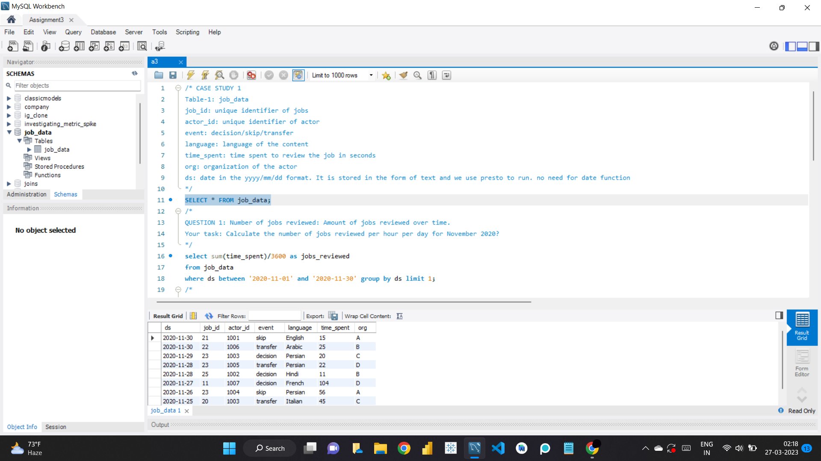
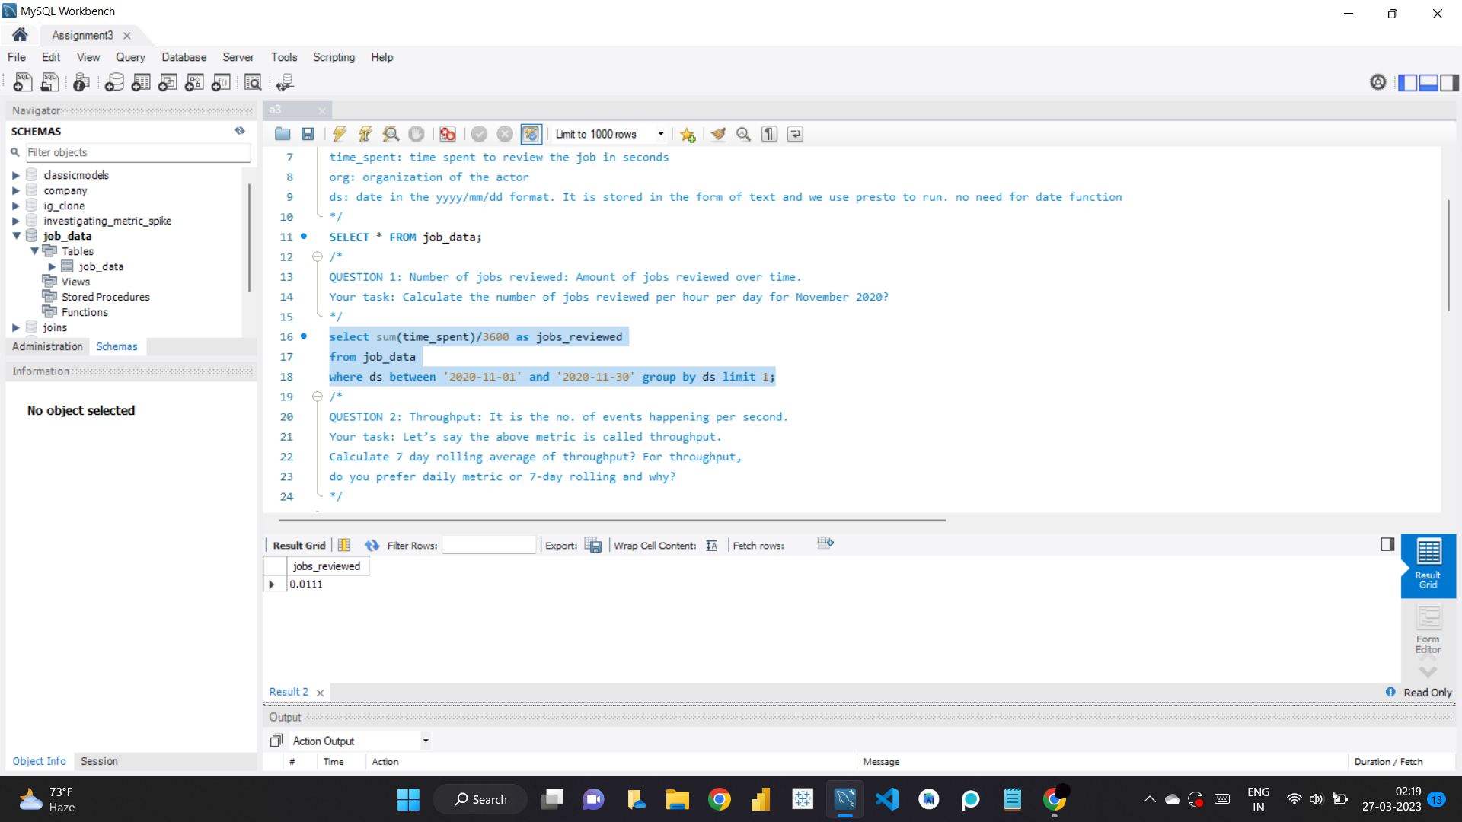

Slide 26
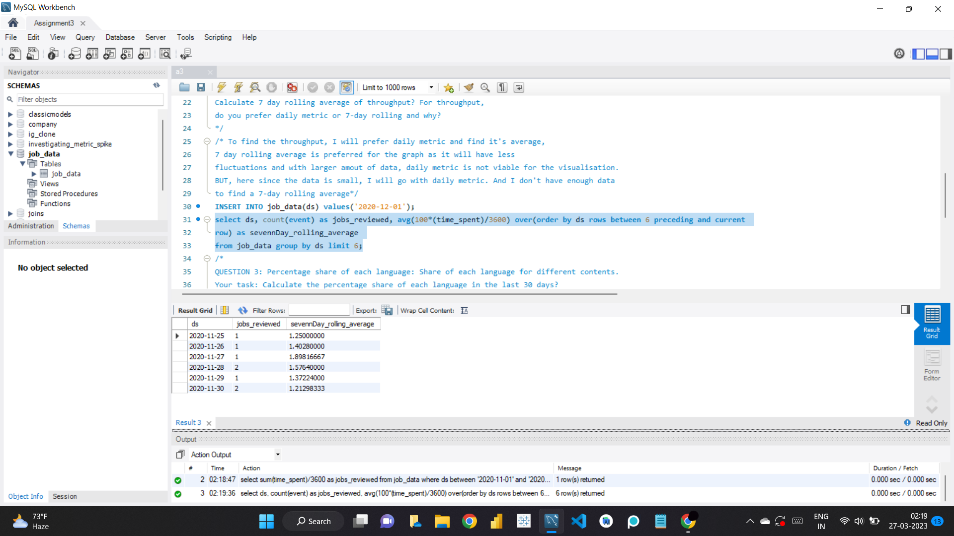
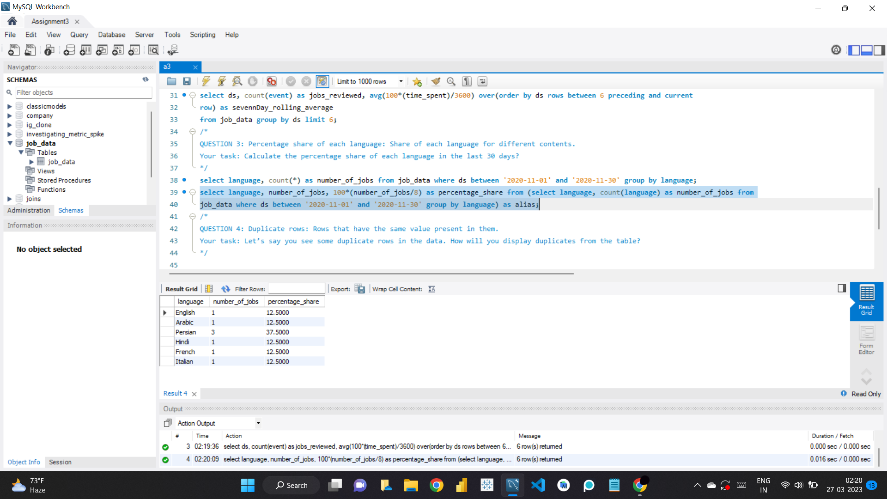

Slide 27
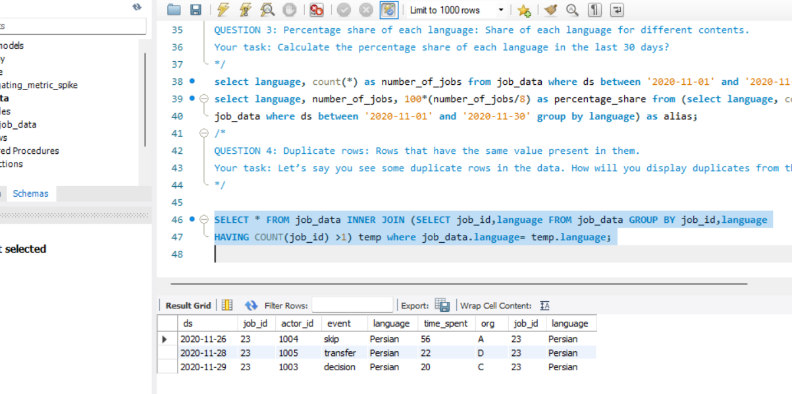

Slide 28
CASE STUDY 2
User Engagement: To measure the activeness of a user. Measuring if the user finds quality in a product/service. Your task: Calculate the weekly user engagement?
User Growth: Amount of users growing over time for a product. Your task: Calculate the user growth for product?
Weekly Retention: Users getting retained weekly after signing-up for a product. Your task: Calculate the weekly retention of users-sign up cohort?
Weekly Engagement: To measure the activeness of a user. Measuring if the user finds quality in a product/service weekly. Your task: Calculate the weekly engagement per device?
Email Engagement: Users engaging with the email service. Your task: Calculate the email engagement metrics?

Slide 29
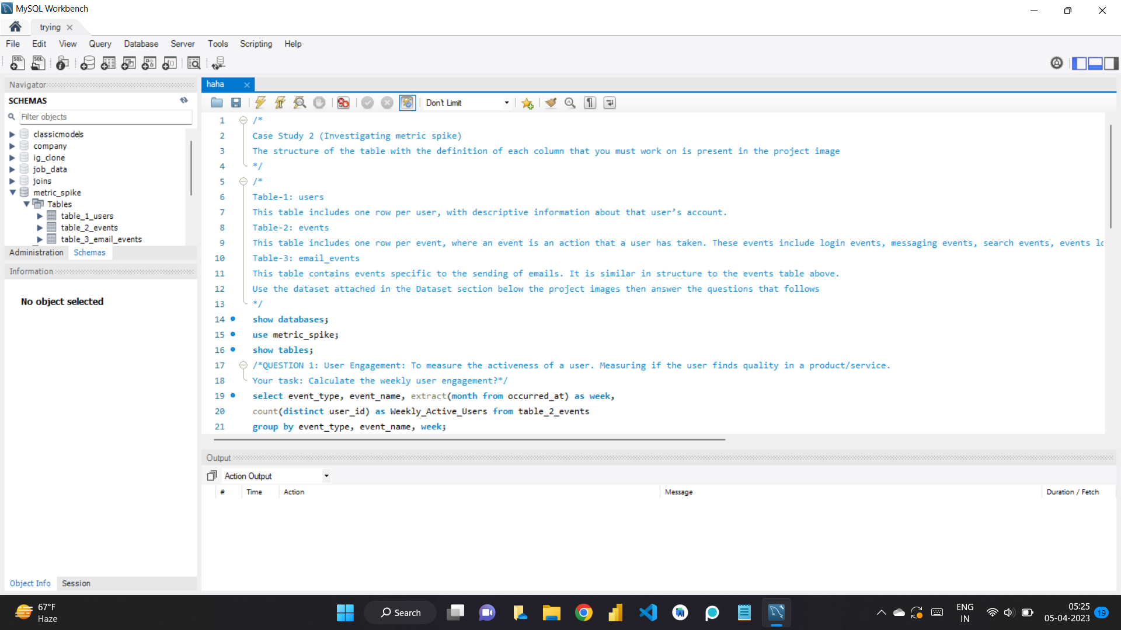
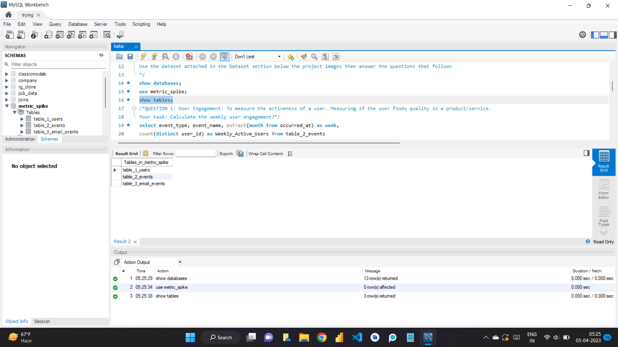

Slide 30
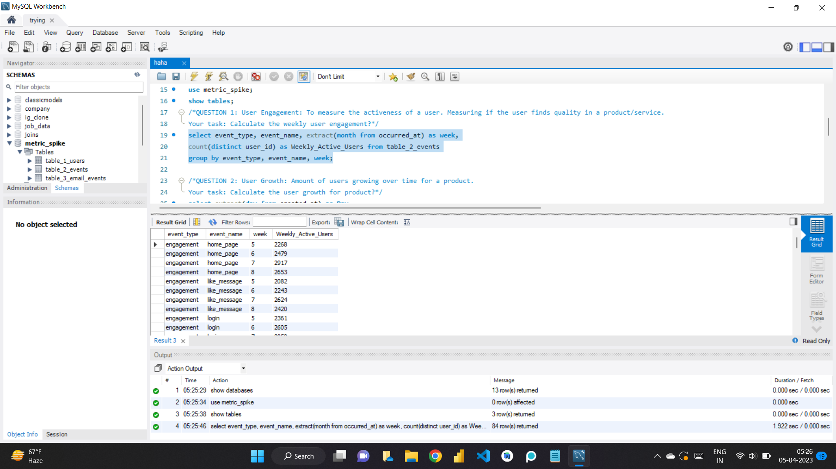
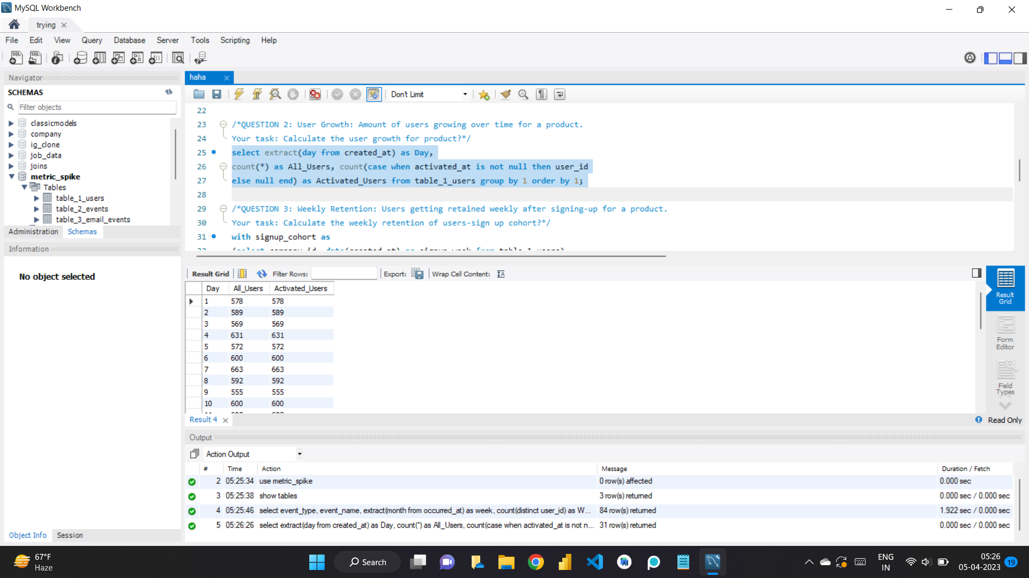

Slide 31
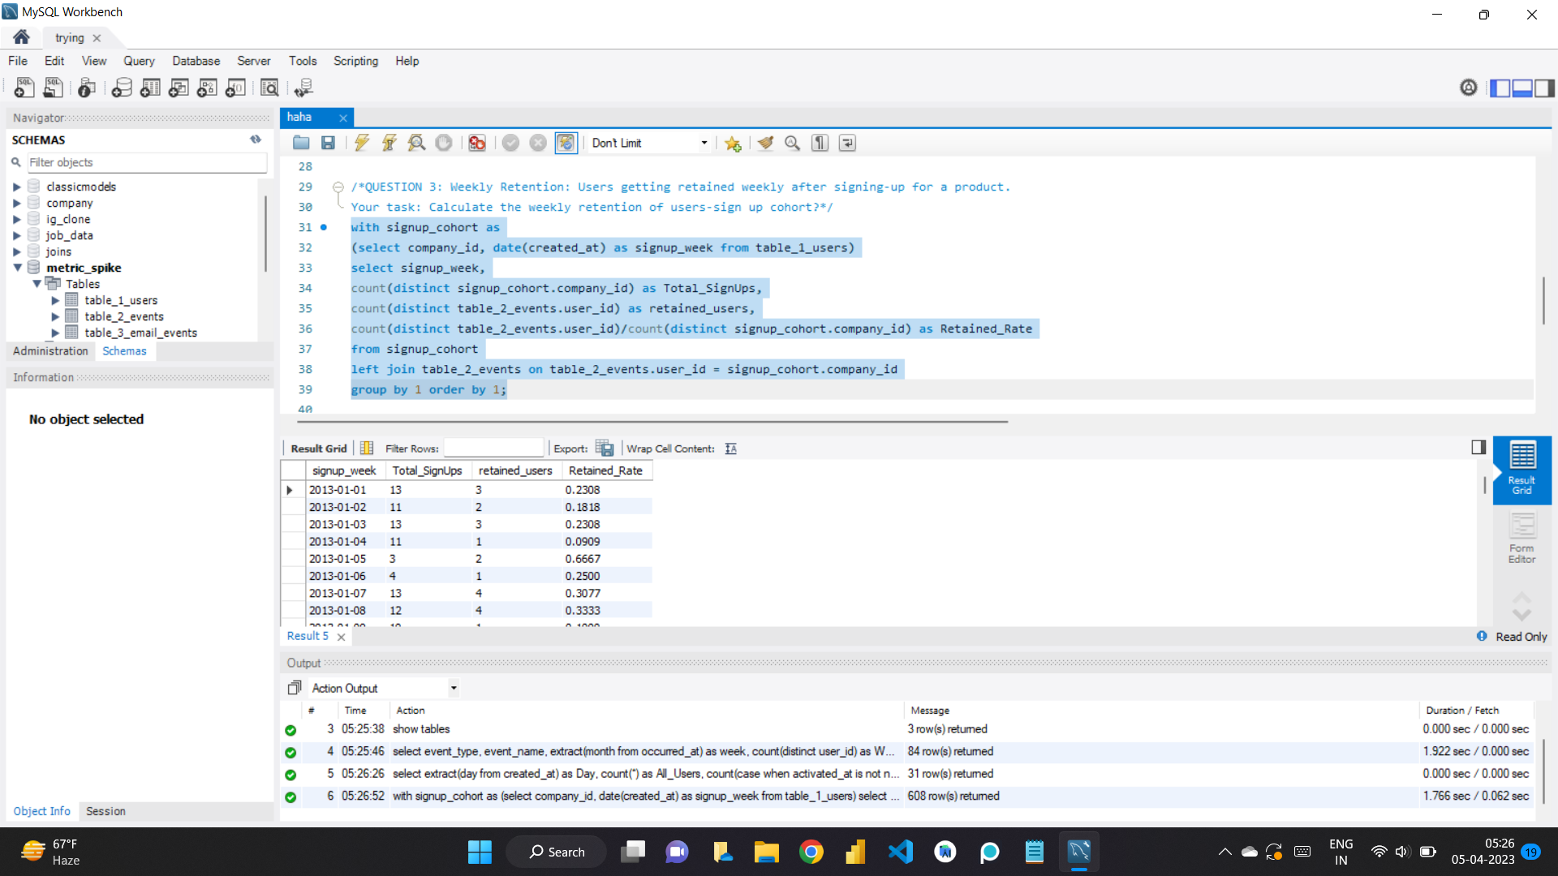
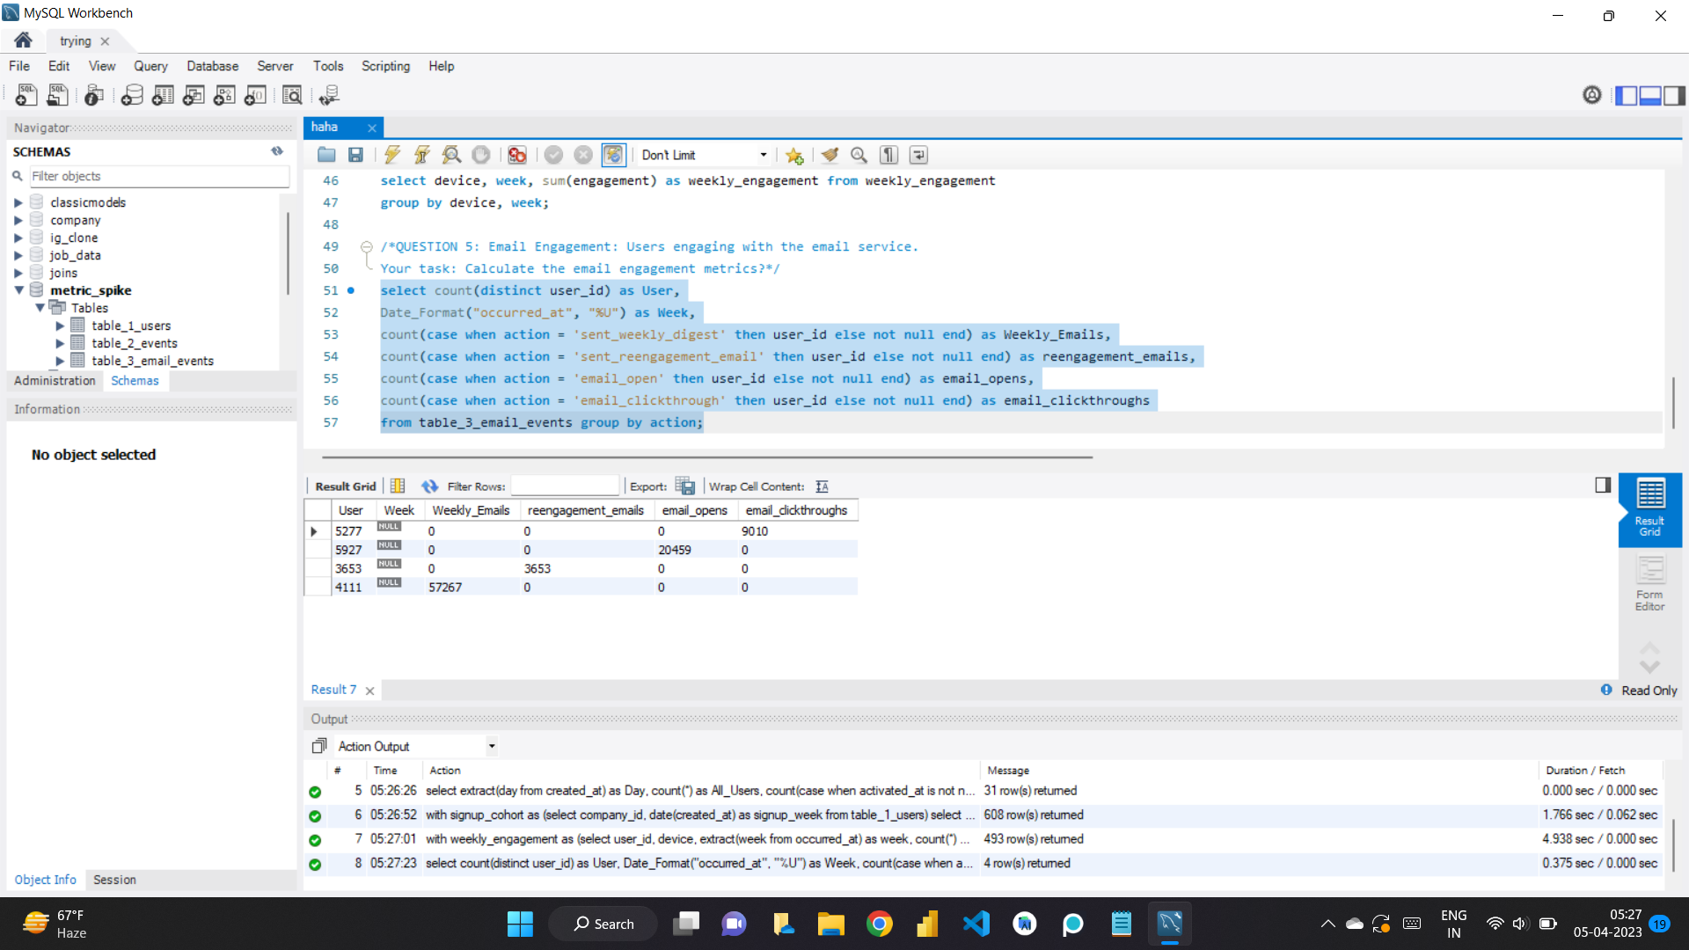

Slide 32
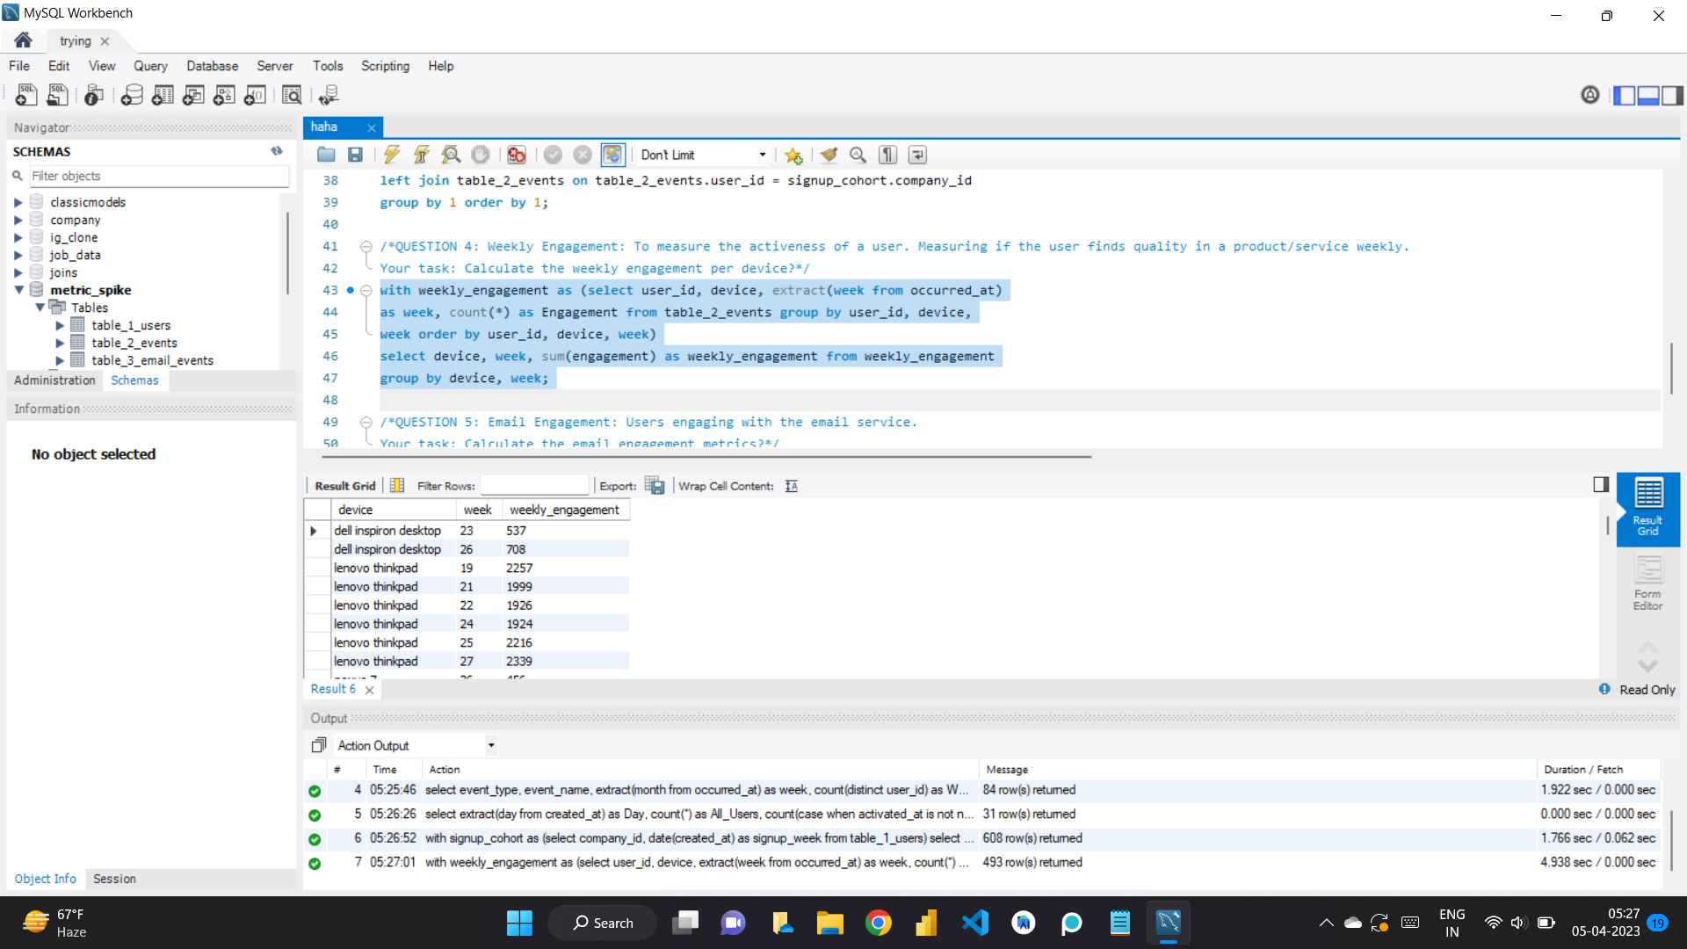

Slide 33
INSIGHTS
Firstly this project taught me new concepts as the data was too big and it caused a lot of problem while importing and due to that reasons I shifted to jupyter Notebook and Tableau and hence got to learn about few different libraries though I felt completing it in the MySQL Workbench and hence I had to flush privileges in the MySQL Command Line as it was causing few errors so basically troubleshooting.

Slide 34
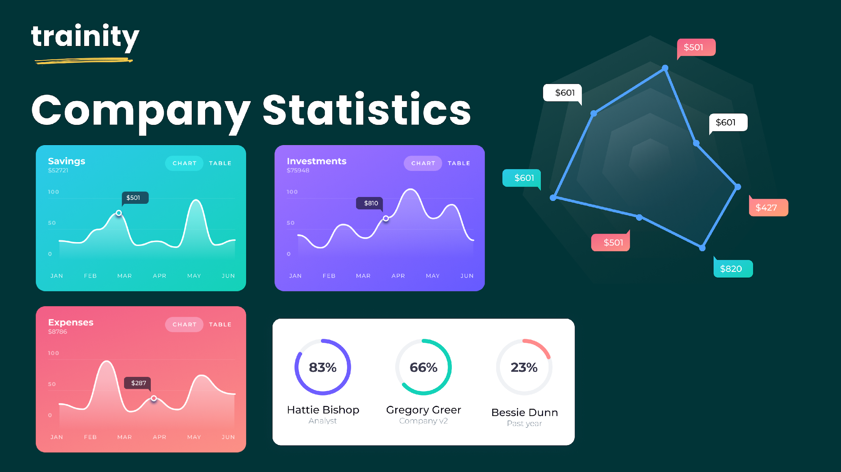
HIRING PROCESS ANALYTICS:

Slide 35
DESCRIPTION:
Hiring process is the fundamental and the most important function of a company. Here, the MNCs get to know about the major underlying trends about the hiring process. Trends such as- number of rejections, number of interviews, types of jobs, vacancies etc. are important for a company to analyse before hiring freshers or any other individual. Thus, making an opportunity for a Data Analyst job here too! As a Data Analyst, my job is to go through these trends and draw insights out of it for hiring department to work upon.
I am given a dataset of a company where the details about people who registered for a particular post in a department of this company. I am required to use my knowledge in statistics and use different formulas in excel and draw necessary conclusions about the company.

Slide 36
APPROACH AND TECH-STACK USED:
Gathering data.
Understanding given dataset and its various columns.
Performing EDA and cleaning data.
Checking for missing values, Clubbing columns with multiple categories and checking for outliers.
Understanding the given questions and solving them.
Analysing data and using visualisation tools and amking charts.
Drawing Data Summary.
TECH-STACK USED:
Microsoft Excel for the data analysis and Word for the documentation.

Slide 37
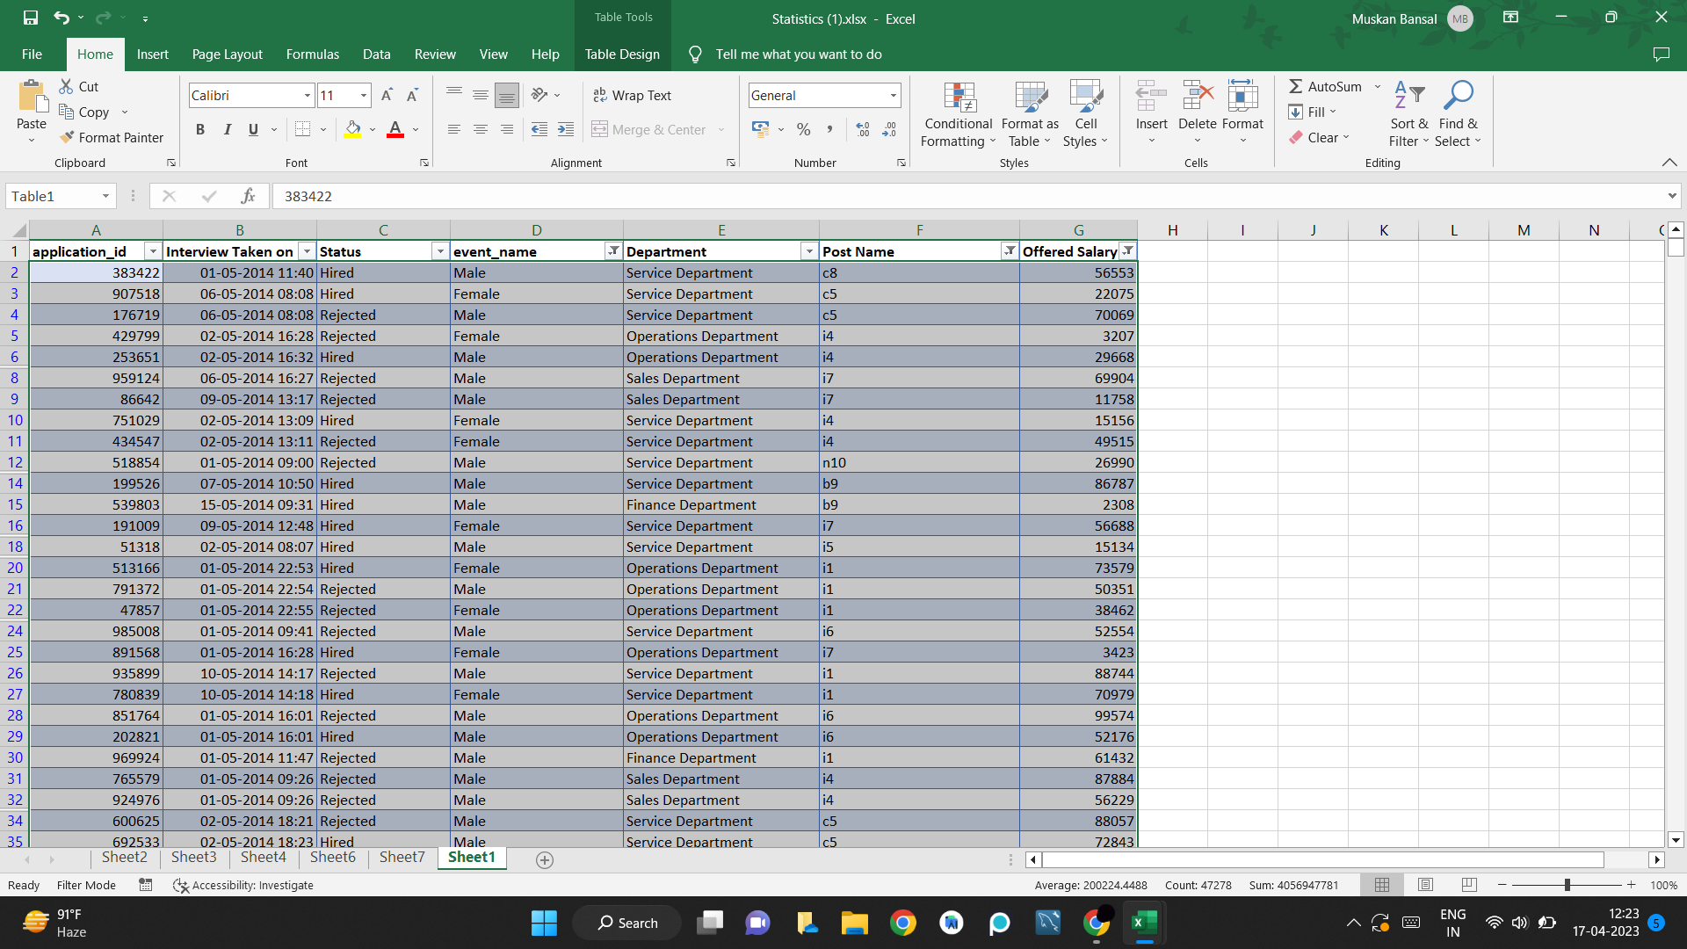
Data Set Provided:
Total Number of Rows: 7168
Total Number of Columns: 7
1. Application_id
2. Interview taken on
3. Status
4. Event_name
5. Department
6. Post name
7. Offered Salary

Slide 38
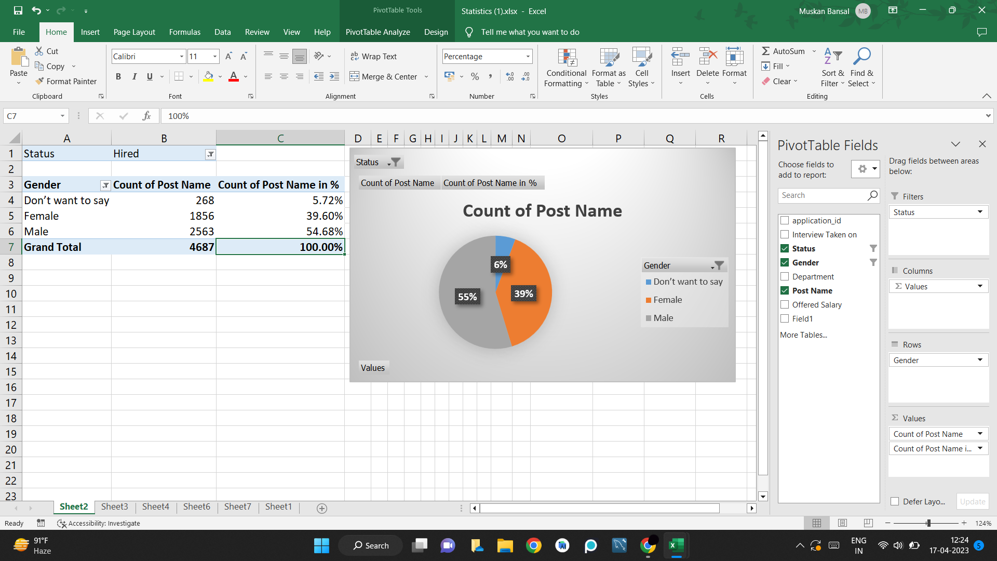
QUESTION1. Hiring: Process of intaking of people into an organization for different kinds of positions. Your task: How many males and females are Hired ?

Slide 39
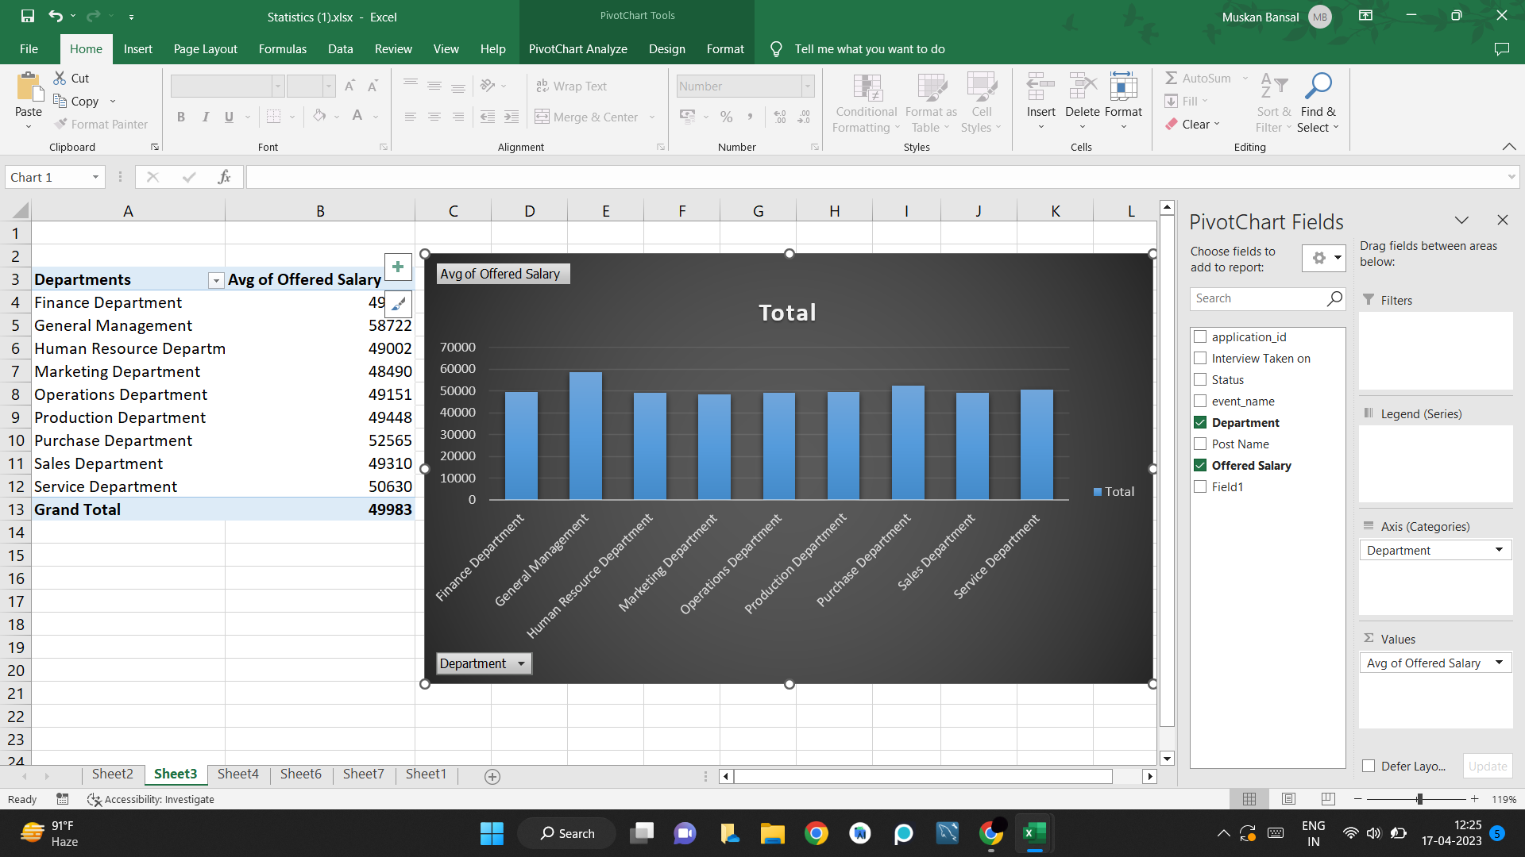
QUESTION2. Average Salary: Adding all the salaries for a select group of employees and then dividing the sum by the number of employees in the group. Your task: What is the average salary offered in this company ?

Slide 40
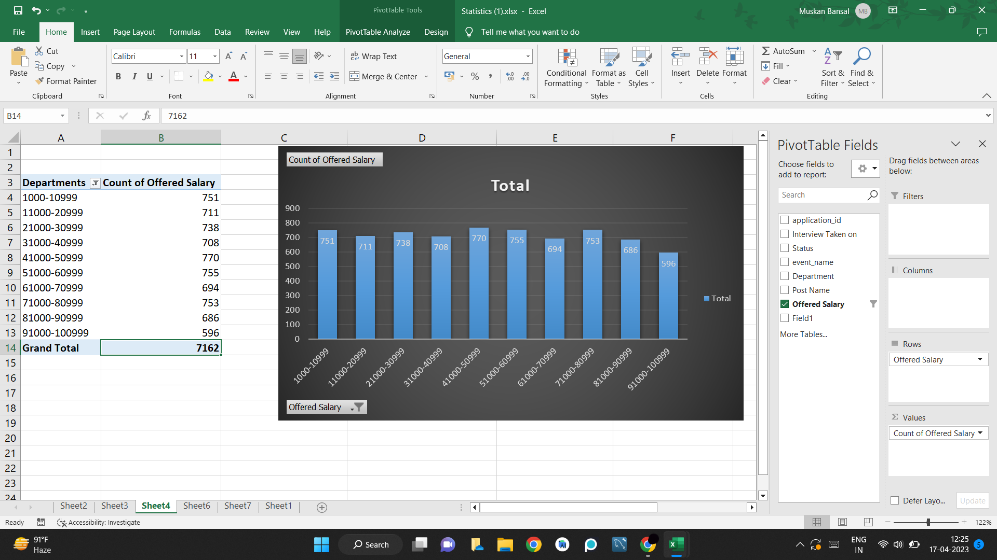
QUESTION3. Class Intervals: The class interval is the difference between the upper class limit and the lower class limit. Your task: Draw the class intervals for salary in the company ?

Slide 41
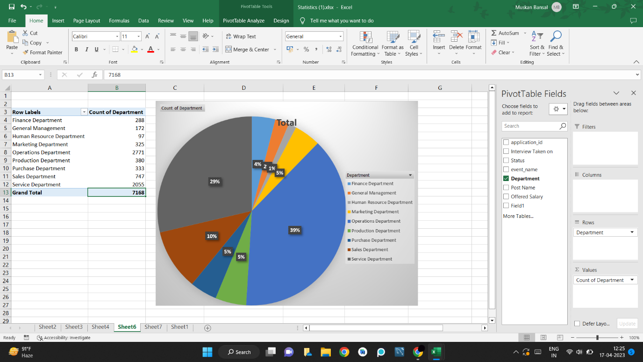
QUESTION4. Charts and Plots: This is one of the most important part of analysis to visualize the data. Your task: Draw Pie Chart / Bar Graph ( or any other graph ) to show proportion of people working different department ?

Slide 42
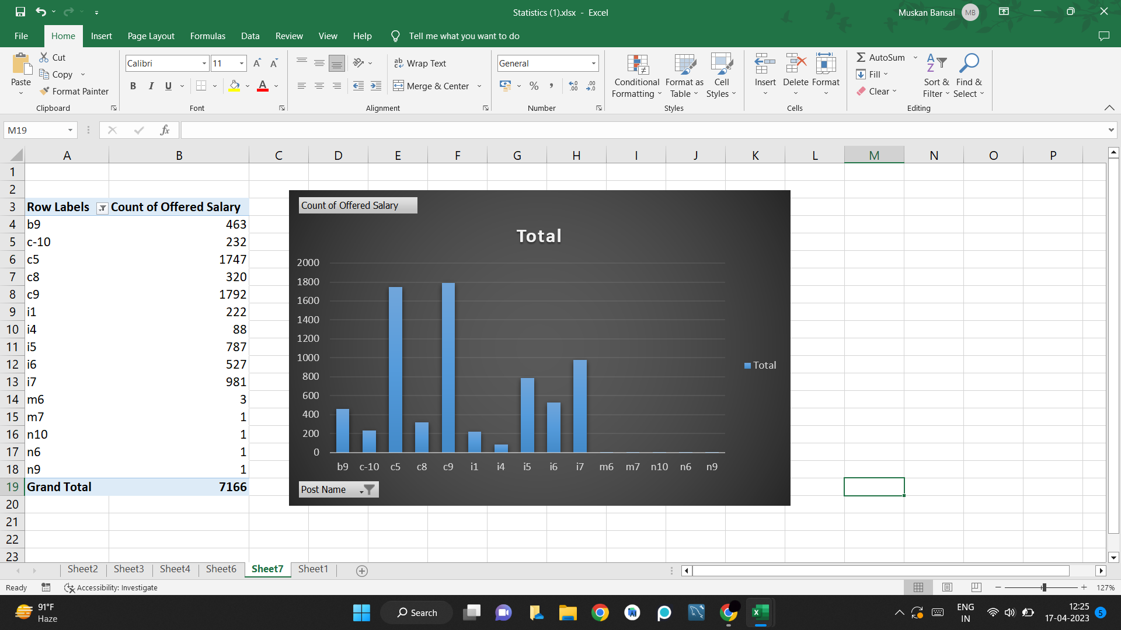
QUESTION5. Charts: Use different charts and graphs to perform the task representing the data. Your task: Represent different post tiers using chart/graph?

Slide 43
CONCLUSION:
About 6% prefer not to disclose their gender, while 55% are male and 39% are female.
General management department has the highest average salary.
Most of the people are earning salary between 41,000-50,999.
4% is in finance department, 2% is in general department, 1% is in HR department, 39% is in operations department, 5% is in production department, 5% is in purchase department, 10% is in sales department and 29% is in service department.
c9 has the most number of people.

Slide 44
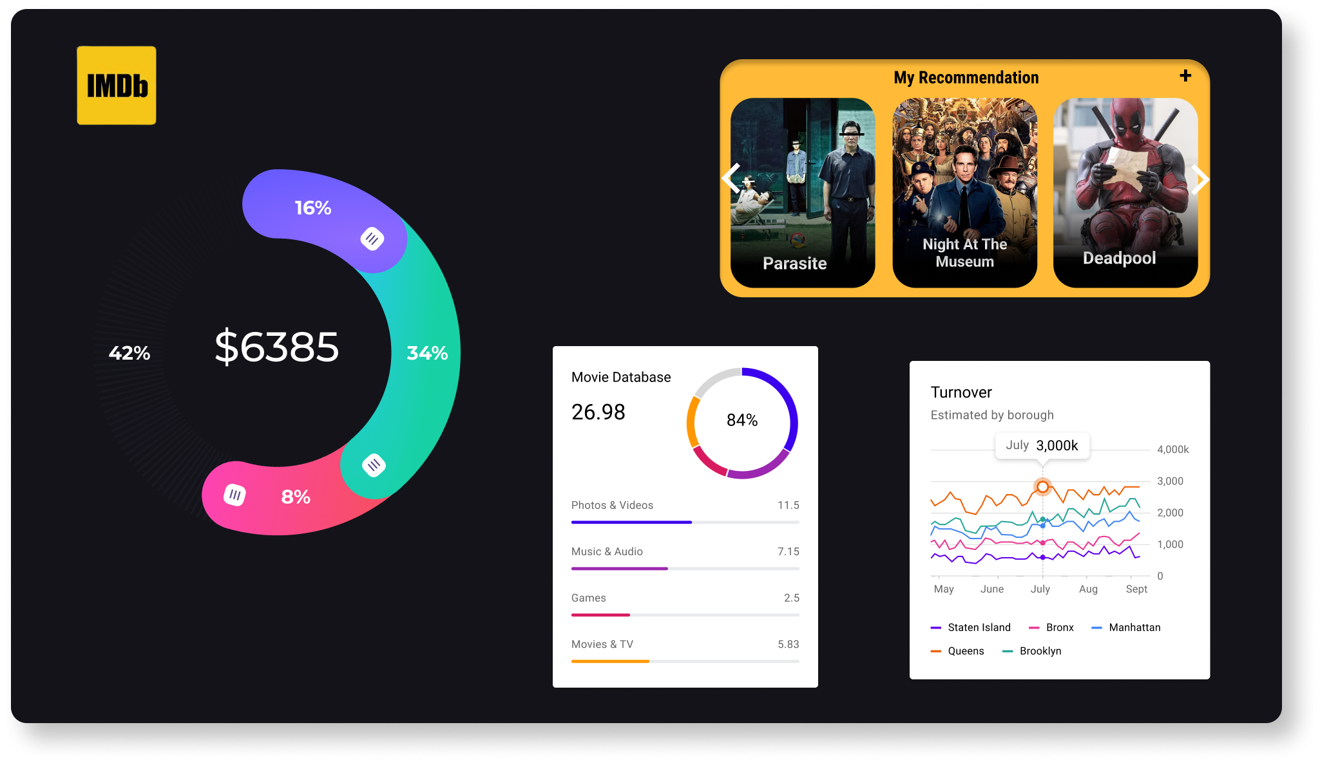
IMDB Movie Analysis:

Slide 45
Description:
In this project I have a dataset having all the information I would need to perform the analysis and answer the questions, columns names are as follows:
Color: Tells if the movie is in Black & white film or color.
Director_name: Has names of all the directors.
Num_critic_for_reviews: Tells the number of critics.
Duration: How long is the movie.
Director_facebook_likes: Number of likes a director has on facebook.
Actro_3_facebook_likes: Number of likes an actor has on facebook.
Actor_2_name: Name of the second actor.
Actor_1_facebook_likes: Number of likes an actor has on facebook.
Gross: Gross is the sum of budget and profit.
Genres: Genere of the movie.
Actor_1_name: Name of the actor.
Movie_title: Nmme of the movie.
Num_voted_users: Number of people voted.

Slide 46
Cast_total_facebook_likes: Total likes on facebook of the cast members.
Actor_3_name: Nmae of actor.
Facenumber_in_poster: Number of faces on the movie poster.
Plot_keywords: Key words to help describe the movie better.
Movie_imdb_link: IMDB Link of the movies.
Num_user_for_reviews: Number of users.
Language: Language of the movie.
Country: Has name of the countries.
Content_rating: Rating of the movie.
Budget: How much money is spend on the movie.
Title_year: Year on which it was released.
Actor_2_facbook_likes: Number of likes on facebook.
Imdb_score: Score on IMDB.
Aspect_ratio: The ratio of the width to the height of an image or screen.
Movie_facebook_likes: Number of likes a movie got on facebook.

Slide 47
Approach AND TECH STACK USED:
1. Understand the dataset provided, load the data and import on excel sheet. Clean the data, remove the null values where needed, remove the outliers, remove the duplicate values where needed, convert the columns in the correct datatype, and create a clean table.
2. Understand the questions and what needs to be answered, make clean and need self-exploratory visualisations (Pi-Charts, Bar-diagrams, etc.) that helps to answer the questions easy.
3. Make a clean and need report. Using 5 Whys Analysis in the analysis and using this to create a report which conveys a data story. Five 'Whys' approach: It's also called the Root Cause Analysis, developed by Sakichi Toyoda, founder of Toyota Industries.
4. Deployment.
Tech-Stack Used:
Excel and Word (Microsoft Office Home and Student 2019) for the purpose of visualisations and report making.

Slide 48
QUESTION1:
Cleaning the data:: This is one of the most important step to perform before moving forward with the analysis. Use your knowledge learned till now to do this. (Dropping columns, removing null values, etc.) Your task: Clean the data.
ANSWER: I cleaned the data, removing null values and duplicate data where necessary and created a clean table with correct datatypes.
QUESTION2:
Movies with highest profit: Create a new column called profit which contains the difference of the two columns: gross and budget. Sort the column using the profit column as reference. Plot profit (y-axis) vs budget (x- axis) and observe the outliers using the appropriate chart type. Your task: Find the movies with the highest profit?
ANSWER: The name of the sheet in the sxcel is “Question2” where I copied the movie_title, budget and gross columns and the I created another column “Profit” that stores the difference between budget and gross. The I selected the top 20 movies with the highest profit margin and plotted a bar graph for the same.

Slide 49
Then as was asked in the question, I also made a scatter chart that is also known as bubble chart where on the Y axis is the profit and that on the x axis is the budget., the scatter chart is a nice way to visualise and check for the outliers. While The Avengers has the highest profit margin, Start wars and E.T the extra terrestrial are the two top movies with lowest budget and highest profit.

Slide 51
QUESTION3:
Top 250: Create a new column IMDb_Top_250 and store the top 250 movies with the highest IMDb Rating (corresponding to the column: imdb_score). Also make sure that for all of these movies, the num_voted_users is greater than 25,000. Also add a Rank column containing the values 1 to 250 indicating the ranks of the corresponding films. Extract all the movies in the IMDb_Top_250 column which are not in the English language and store them in a new column named Top_Foreign_Lang_Film. You can use your own imagination also! Your task: Find IMDB Top 250.
ANSWERS:
First I copied the required columns on a new sheet and then I first ranked the num_Voted_users and removed all the datasets with value less than 25,000, then I also ranked the table on the basis of its IMDB ratings.

Slide 52
The above graph shows the top movies(including all the languages) with highest to low IMDB ratings and the length of the bars represents the number of voted users.

Slide 53
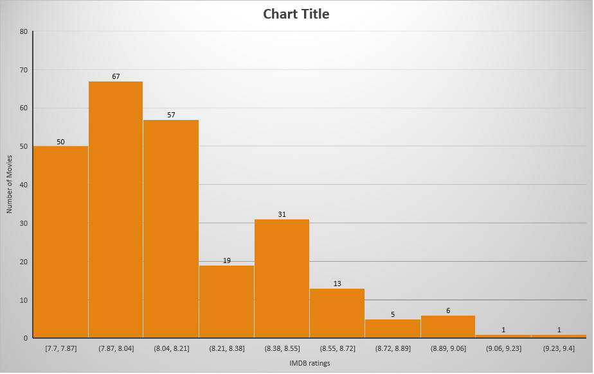
The above graph shows that most of the movies got ratings between 7.87-8.04.

Slide 54
The above bar graph tells the highest to low IMDB ratings, 9.3 being the highest.(Including all the languages)

Slide 55
The above bar graph tells the highest to low IMDB ratings, 9.3 being the highest.(Including only english movies.)

Slide 56
The above bar graph tells the highest to low IMDB ratings, 9.3 being the highest.(Including all non-english movies.)

Slide 57
QUESTION4:
Best Directors: Group the column using the director_name column. Find out the top 10 directors for whom the mean of imdb_score is the highest and store them in a new column top10director. In case of a tie in IMDb score between two directors, sort them alphabetically.
Your task: Find the best directors
ANSWER:
First I copied the necessary columns in a new sheet and named it as Question4, I copied the columns movie_title, director_name and indb_score.
Then I arranged the table on the basis of IMDB ratings in ascending order, calculated the mean IMDB rating which was 6.48 and removed all the data having ratings below that.

Slide 58
The above bar graph represents the names of all the directors with the top 10 ratings. Frank Darabot with the highest rating of 9.3.

Slide 59
QUESTION5: Popular Genres: Perform this step using the knowledge gained while performing previous steps. Your task: Find popular genres. ANSWER: The above bar graph shows all the genres in an descending order where drama being the most popular genre out of the all.

Slide 61
QUESTION6:
Charts: Create three new columns namely, Meryl_Streep, Leo_Caprio, and Brad_Pitt which contain the movies in which the actors: 'Meryl Streep', 'Leonardo DiCaprio', and 'Brad Pitt' are the lead actors. Use only the actor_1_name column for extraction. Also, make sure that you use the names 'Meryl Streep', 'Leonardo DiCaprio', and 'Brad Pitt' for the said extraction. Append the rows of all these columns and store them in a new column named Combined. Group the combined column using the actor_1_name column. Find the mean of the num_critic_for_reviews and num_users_for_review and identify the actors which have the highest mean. Observe the change in number of voted users over decades using a bar chart. Create a column called decade which represents the decade to which every movie belongs to. For example, the title_year year 1923, 1925 should be stored as 1920s. Sort the column based on the column decade, group it by decade and find the sum of users voted in each decade. Store this in a new data frame called df_by_decade. Your task: Find the critic-favorite and audience-favorite actors.
ANSWER:
First, I copied all the necessary columns required for the visualisations and answering the questions in a new sheet and named it as question6.The I created a new table that only had names of the movies done by the 3 actors as mentioned.

Slide 63
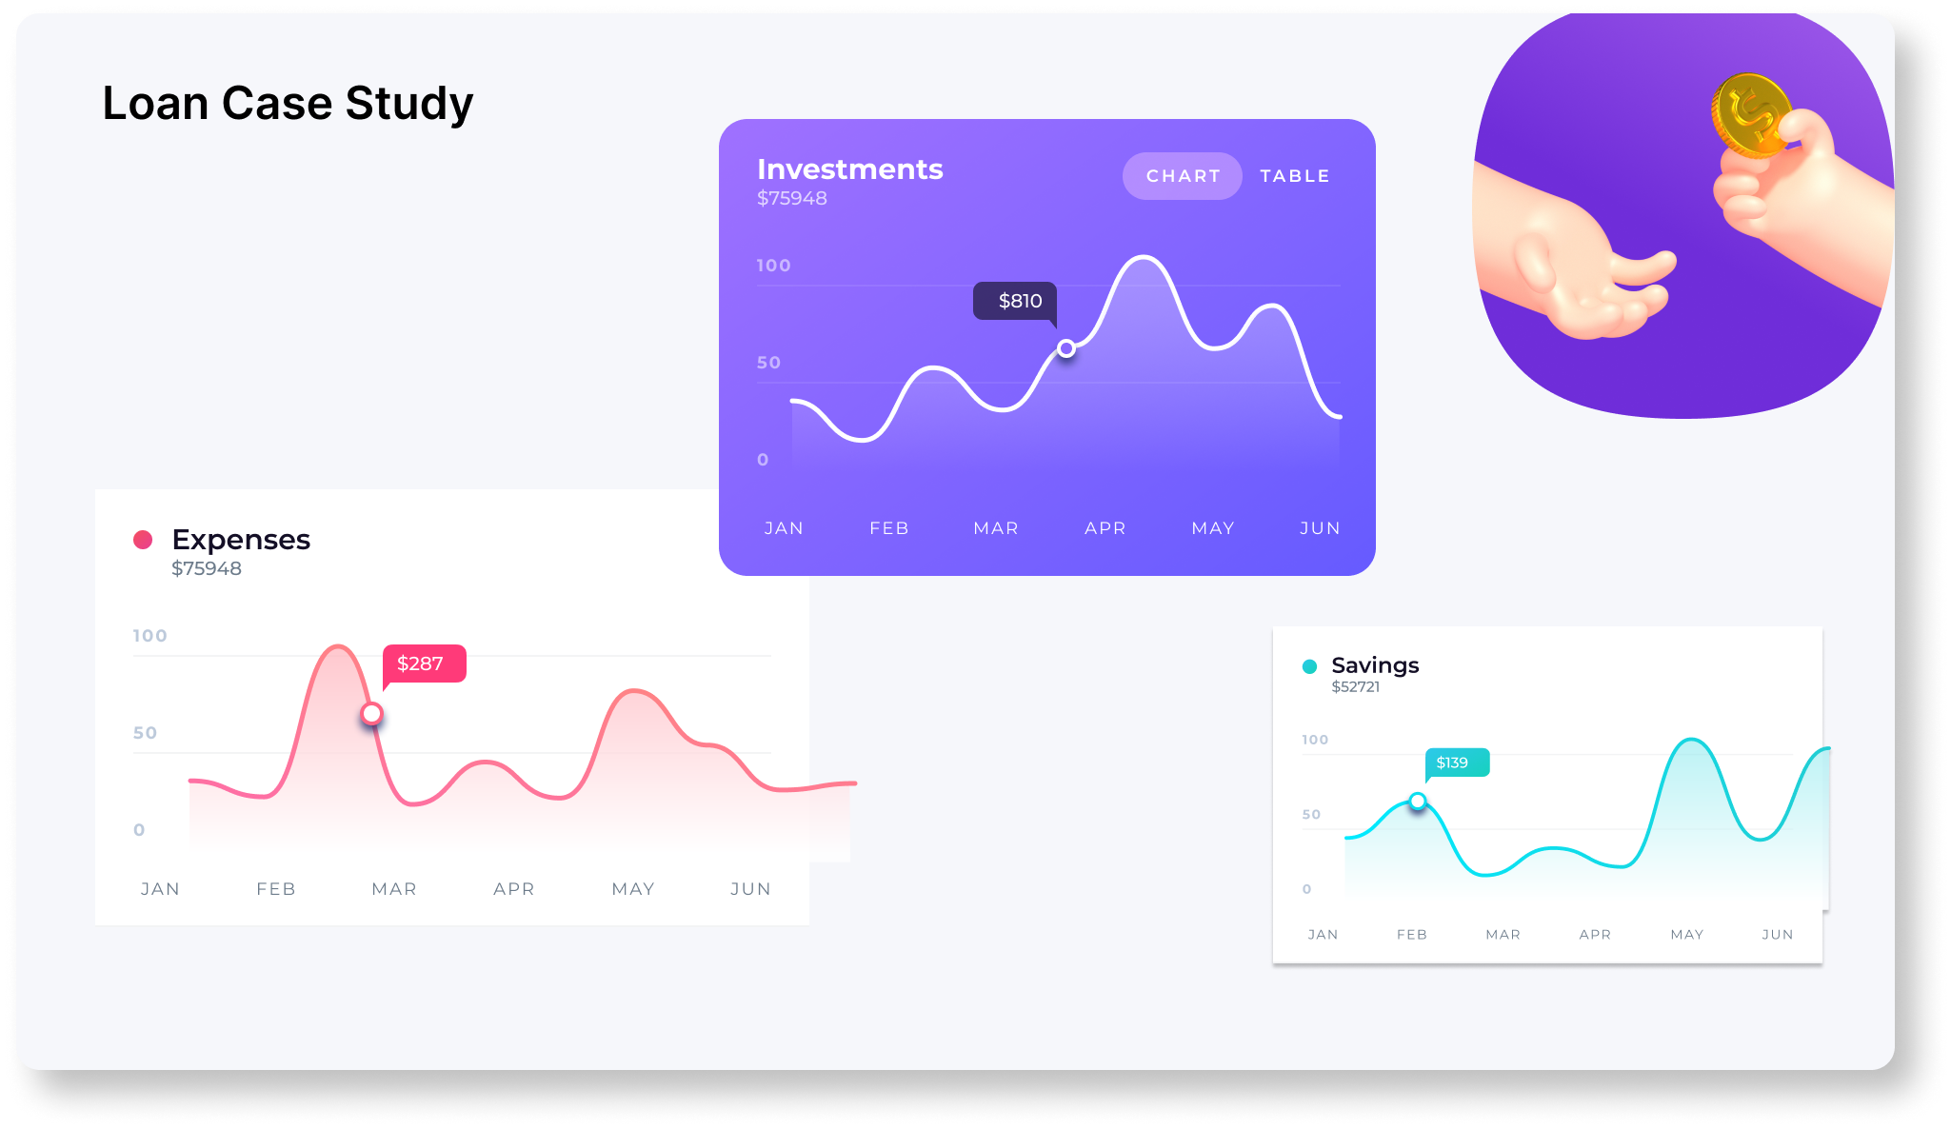
Bank Loan Case Study

Slide 64
DESCRIPTION:
BANK LOAN CASE STUDY:
Study aims to identify patterns which indicates if the client has problems paying instalments that may be used for taking required actions like denying the loan, reducing the amount of loan, lending (to risky applicants) at a higher interest rate, etc. Ensuring that consumers capable of repaying the loan aren’t rejected. Basically, company wants to understand driving factors behind loan defaults, i.e. the variables which are strong indicators of default. The company can utilize this knowledge for its portfolio and risk assessment.
To understand driving factors behind loan defaulters.
I, as a Data Analyst have to provide with the problem statement and analyse the approach briefly.
Identify the missing patterns and appropriate methods to deal with them by either removing or deleting the values.
I also identified all the outliers present in the dataset and for any data imbalance.
Then explained results acquired using univariate, segmented univariate and bivariate analysis.
And finally the top 10 correlations for the client with payment difficulties.

Slide 65
DATASET EXPLAINED:
The dataset given has information about the loan application at the time of applying for the loan and it has two types of scenarios:
The client with payment difficulties and, client with payment done on time.
It is necessary to note that when a client applies for the loan, there are usually 4 types of decisions that could be taken by the client or by the company:
APPROVED: The company approved the loan.
CANCELLED: Client cancelled the application during approval.
REFUSED: The company rejected the loan.
UNUSED OFFER: Loan was cancelled by the client.
We have 3 csv files provided:
application_data.csv: Contains all information about the client at the time of application. It contains whether the client has payment difficulties or not.
previous_application.csv: Contains information about the client’s previous loan data. It contains whether the previous application was approved, cancelled, refused or unused.
columns_description.csv: It describes all the columns present in the above two csv files.
TECH_STACK USED: Ms Office Home and Student 2019

Slide 66
Data Cleaning
Application Data and previous application data
► Checking columns for null values and removing those with null values greater than 40% for application data and removing columns having null values greater than 30% for previous application data and the columns which are not necessary for analysis from both the datasets.
► Imputing null values with suitable values (mean or median).
► Binning certain columns into categorical columns which will be used for analysis.
(Binning are of three types, mean, median and boundaries which is a data cleaning method.)
► Checking datatype of variables and converting them into suitable datatypes.
► Checking dataset for duplicates and outliers.

Slide 67
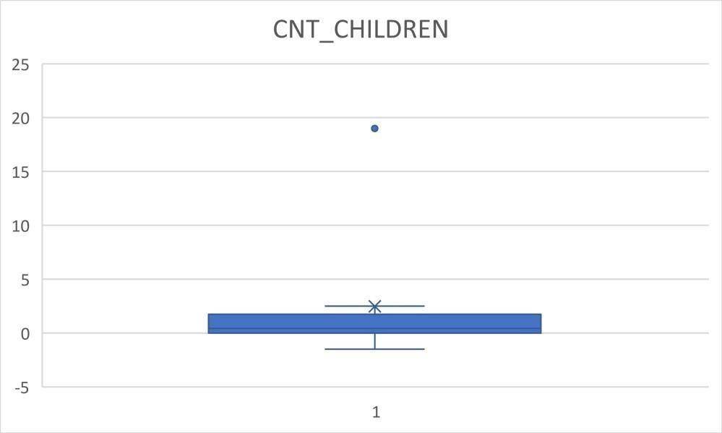
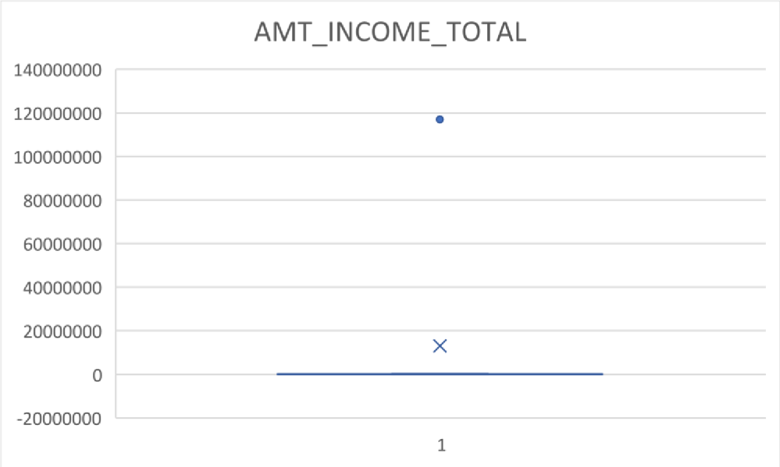
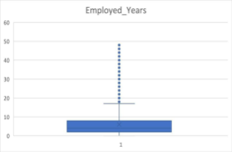
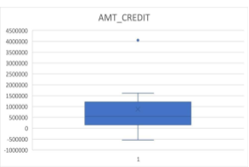
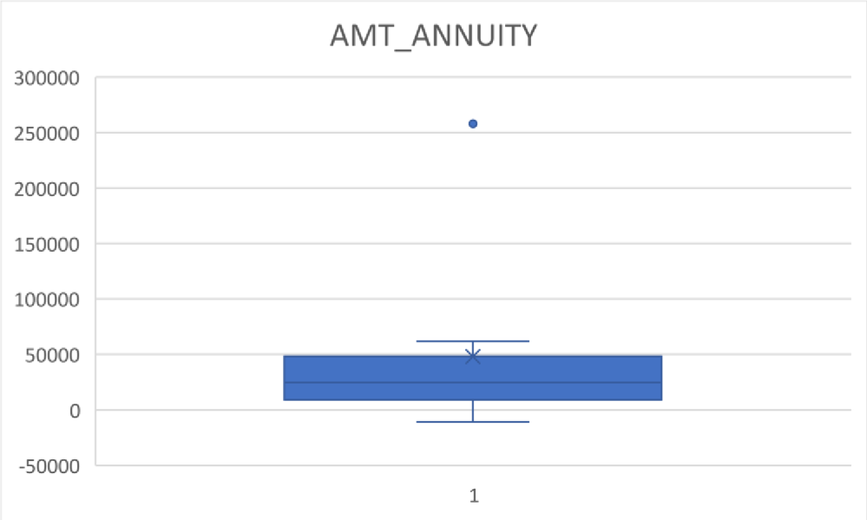
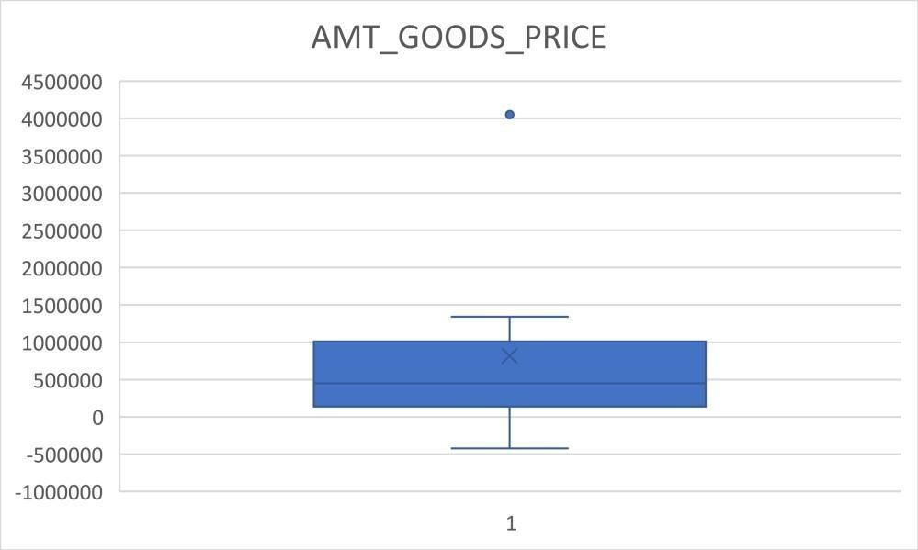
Identification Of Outliers:

Slide 68
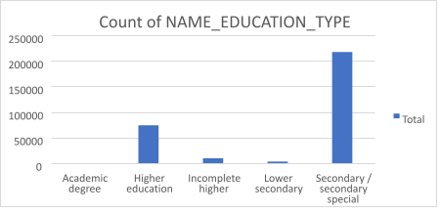
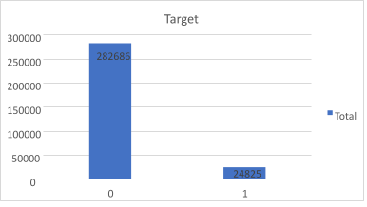
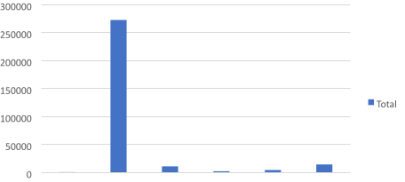
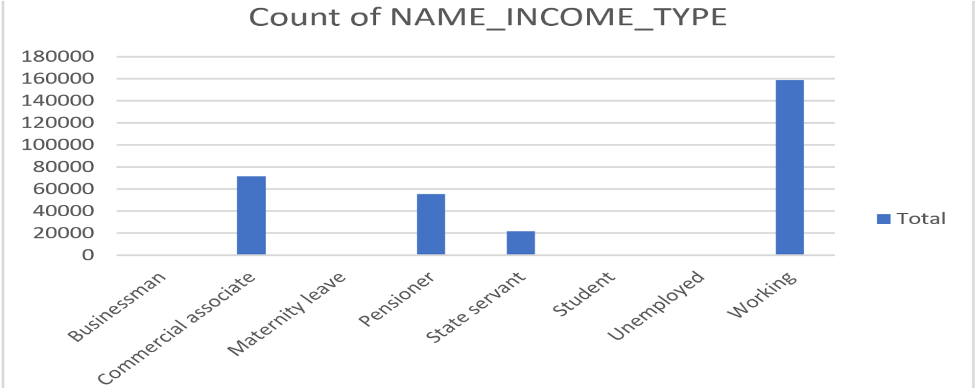
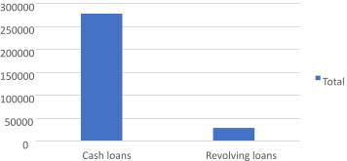
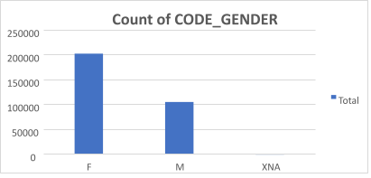
Data Imbalance:
307511
Count
of
NAME_HOUSING_TYPE
Co-op
House
apartment
/
Municipal
Office
Rented
With
apartment
apartment
apartment
apartment
parents

Slide 69
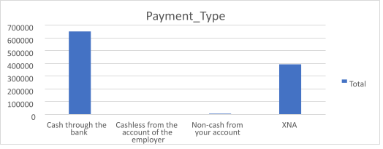
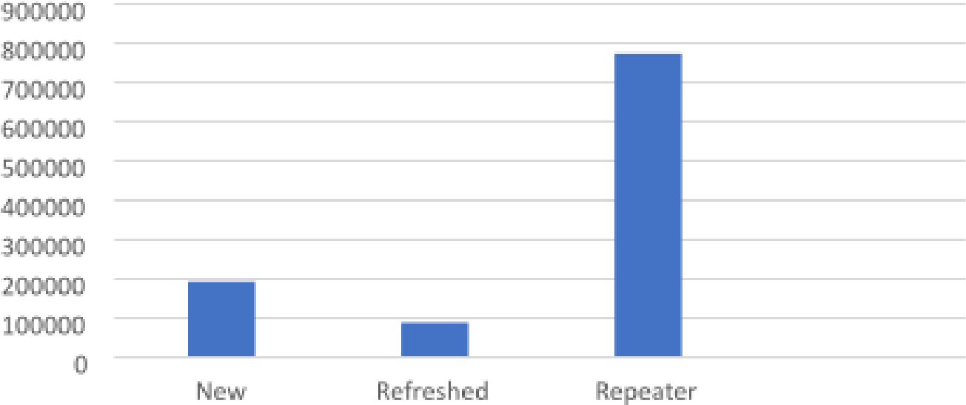
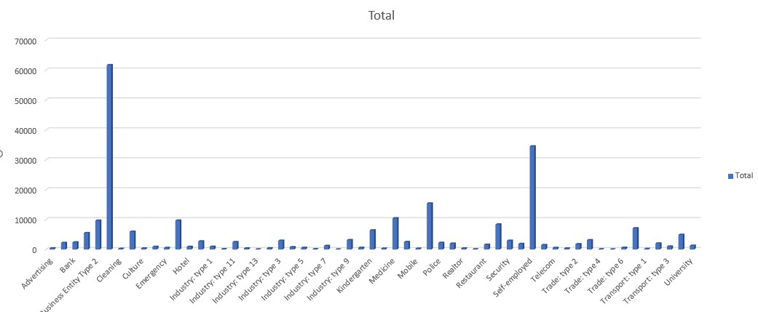
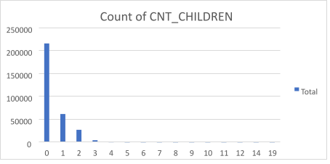
Client_Type
Total
ater
XNA

Slide 70
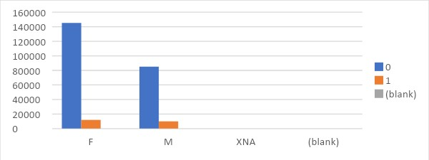
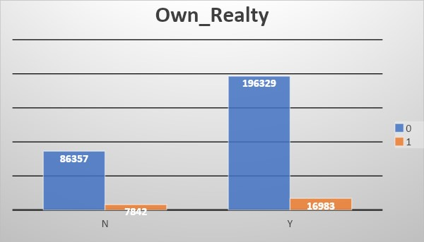


Univariate Analysis On Categorical Columns :

Slide 71






Slide 72





Slide 73





Slide 74





Slide 75


Bivariate Analysis:

Slide 76




Slide 77
Results:-
I learned a lot through this project, firstly it was my first time handeling such a large amount of data and it was difficult to understand all the columns and find which ones are the important ones and while could be deleted.
I learned how banks analyse each and every little details when accepting a loan application which I did not know before, I also understood the importance of data analyst in the financial sector much deeper.
I also learned to draw correlations tables which I did not know before, overall it was a great project with a significant learning curve.
I have also submitted this project before but forgot to add my excel file and hence I am again uploading this project with the attached Excel sheet with a little change to increase readbility.
I also understood that adding a description page before the project in the Excel sheet is very handy, so I added that as well.

Slide 78
Conclusion:-
Majority of the people who have applied for the loans are females and mostly have opted for cash loans, while male applicants with higher income have defaulted more. However, applicants belonging to higher income group were able to repay loans on time.
Banks should focus more on students, pensioners and businessmen and with housing type as co-op apartment since they repay the loans. It is also observed that people with ‘working’ income type have the most difficulty in repaying the loans so they can be avoided.
Applicants with greater work ex are credited higher loans.
Higher the price of the goods, higher will be the loan amount. Hence, AMT_CREDIT and AMT_GOODS_PRICE are positively correlated.
With higher loan amount credited, higher will be the annuity. Therefore, AMT_CREDIT and AMT_ANNUITY are positively correlated.

Slide 79

Analysing the Impact of Car Features on Price and Profitability

Slide 80
Problem Statement:
The automotive industry has been rapidly evolving over the past few decades, with a growing focus on fuel efficiency, environmental sustainability, and technological innovation. With increasing competition among manufacturers and a changing consumer landscape, it has become more important than ever to understand the factors that drive consumer demand for cars.
In recent years, there has been a growing trend towards electric and hybrid vehicles and increased interest in alternative fuel sources such as hydrogen and natural gas. At the same time, traditional gasoline-powered cars remain dominant in the market, with varying fuel types and grades available to consumers.
For the given dataset, as a Data Analyst, the client has asked How can a car manufacturer optimize pricing and product development decisions to maximize profitability while meeting consumer demand?

Slide 81
Approach AND TECH-STACK USED:
To implement this project, I utilized Microsoft Office Excel. Firstly, I imported the given datasets into the software and carefully analysed each column and its attributes. I also checked the connections between different columns. During the analysis, I identified null and duplicate values and removed them to improve the accuracy of the results. Pivot tables were very helpful in performing the project tasks as they allowed me to connect different columns and perform various analyses.
Tech used:-
Microsoft Excel 2019
Microsoft Word
Functions Used: COUNTIFS, AVERAGEIFS, Pivot Tables, Regression Analysis, Ancoding Categorical variables, MIN, MAX, Conditional Formatting, CORREL, VBA, etc.

Slide 82
Exploratory Data Analysis:-
Cleaning:-
For cleaning the data I have to calculate the null values.
Here in this data set I have multiple types of data present related to car, I have 16 columns and 11159 rows each columns represents the multiple type of data.
I used countblank(range) function to calculate the null values present in the dataset.
Some of the formulas I used to calculate to find the percentage of the blank values is : =countblank(range)/counta(range)*100
we have to calculate the OUTLIERS using the various techniques.
To find the outliers I used the box plot and after finding the box plot I will remove those outliers. Some of the outliers are given below.

Slide 83






OUTLIERS:

Slide 84
Tasks: Analysis

Slide 86
INSIGHT:

Slide 92
CONCLUSION:
Crossover is the most popular market category followed by exotic and luxury.
Also, crossover seems to have the most number of models.
With the increase of the HP, price also increases.
There was a huge rise of price after 2000, it is also observed that with increase of Engine’s HP, the price has increased too.
Rolls-Royce is the most expensive manufacturer followed by Bentley, Spyker and Ferrari respectively.
Engine Hp, Engine Cylinders and Popularity seems to follow a positive trend line signifying these are the factors that are important in determining the car’s prises.
Mostly, with the increase in the number of engine cylinders, the fuel efficiency also increases, however, in case of Tesla, even with significant low number of Engine Cylinders compared to others, the fuel efficiency is the highest.
Also, Bughati has the most number of average cylinders but still the efficiency is pretty low.
Most commonly regular unleaded fuel is used followed by premium unleaded and flex-fuel.
Convertible is the most expensive, while 2 dr Hatchback, 4Ha Hatchback, Sedan and Wagon seems most desirable, Since, it has lower price and better avg city and Highway MPG.
Chevrolet is the most expensive followed by Cadillac followed by Volkswagon followed by Toyota.
Mostly, large and compact are preferred over Midsize.

Slide 93
13. Bentley is the most pricey followed by Spyker and Maserati while least expensive ones are Plymouth followed by Genesis and Hummer, FIAT, Skion, Oldsmobile.
14. For Bentlay, Coupe, Convertible and Sedan, almost all three are equally popular.
15. While, in case of Plymouth, Convertible is more popular than Sedan.
16. Rolls-Royce is most expensive followed by Bentley and Spyker respectively, while Bentley has low Average City MPG with greatest Engine HP, Spyker has both high City MPG and Engine Hp. We can divide the chart into 4 equal parts and put them into categories like:
High Engine HP and Low Average City MPG
High Engine HP and High Average City MPG
Low Engine HP and Low Average City MPG
Low Engine HP and High Average City MPG
17. In order to increase the popularity, the above mentioned points should be considered and more focus on the product development using the above features.
18. Since, we don’t seem to have enough data about the manufacturing cost of the cars and the features, profitability can’t be analysed well.

Slide 94

ABC Call Volume Trend Analysis

Slide 95
Description:
So for the final project, I was provided with a dataset of a Customer Ex. (CX) inbound calling team for 23 days. Data included a lot of columns like:
Agent_Name, Agent_ID, Queue_Time, Time, Time_Bucket, Duration, Call_Seconds, Call_Status etc. My role as a Data Analyst is to understand the data provided and find when is the maximun number of calls are made during the day and how can I improve the overall CX by reducking the amount of declined calls percentage.
So, as a Analyst I have to answer the questions as questioned and analyse how many agents are needed to decrease the percentage of declined calls.

Slide 96
Approach AND TECH-STACK USED:
So first I read all the columns and after having some understanding about the data, I created a table and checked all the datatypes. Few columns were not needed but I did not delete those columns as the data was not so huge.
My next task was simple to answer all the questions, I used pivot tables for answering few questions while I also created bar graphs for the purpose of better visualisations and understandings. I also had to use basic maths and functions like round() to answer questions.
Lastly, I created the report and wrote the insights.
Tech-Stack Used: Ms Excel for the purpose of answering the questions, making pivot tables and visualisations. And Ms Word, for reporting and writing useful insights.

Slide 97
Case Study Objectives:
16000
Count of
14000
Customer_
12000
Phone_No
10000
8000
6000
Total
4000
206
2000
204
0
9
_
10
10
_
11
11
_
12
12
_
13
13
_
14
14
_
15
15
_
16
16
_
17
17
_
18
18
_
19
19
_
20
20
202
_
21
200
198
196
Total
AGENTS_NEEDED
194
8
192
190
7
188
6
186
5
4
3
2
1
0
9
_
10
10
_
11
11
_
12
12
_
13
13
_
14
14
_
15
15
_
16
16
_
17
17
_
18
18
_
19
19
_
20
20
_
21

Slide 98
Conclusions:
CX is very important for any company and the role of a data analyst to analyse and make sure to provide with the necessary workforce details is necessary.
There are multiple ways that can ensure a customer’s satisfaction and multiple tools available as well like suggestion boxes where customer’s can mail their issues or post about it on their official websites or a CRM tool, taking surveys, analysing business behaviour etc.
While the average call_seconds increases as the day progress with 10-11 being the highest, the average number of calls decreases as the day progresses.
This means that the duration of calls are less in the evening and hence more calls can be made but as the day progresses, the duration of calls increases and hence with the progression, calls are less.
Average call_seconds is 198.6227745 which we found in question 1.
Even though agents work for total 7.5 hrs, only 60% is the actual working hours that sums up to, 60% of 7.5 hrs, which equals to 4.5 hrs. Hence, 4.5 hrs is the actual working hours. And after calculating it waas observed that 30% calls are declined and to decrease that percentage to 10, we need total 62 agents as the answer was calculated in decimals (ie 61.5 but it can’t be in decimal).
We already had 41 people so we will need 21 more people to decrease the abandoned calls percentage to 10.
As for the last question, since it was mentioned that if 100 calls are made overall in a single day then 30 calls are made during night that means 30% calls are made during night-time so to deal with the night calls, we will require 19 people.

Slide 99
Appendix:
Google Sheets Link For Project Data Analytics Process –
Google Sheets Link For Project Instagram user Analytics –
Google Sheets Link ForProject Operation Analytics and Investigating Metric Spike –
Google Sheets Link For Project Hiring Process Analytics –
Google Sheets Link For Project IMDB Movie Analysis -
Google Sheets Link For Project Bank Loan Case Study –
Google Sheets Link For Project Impact of Car features –
Google Sheets Link For Project ABC Car Volume Trend Analysis –

